Slide 1
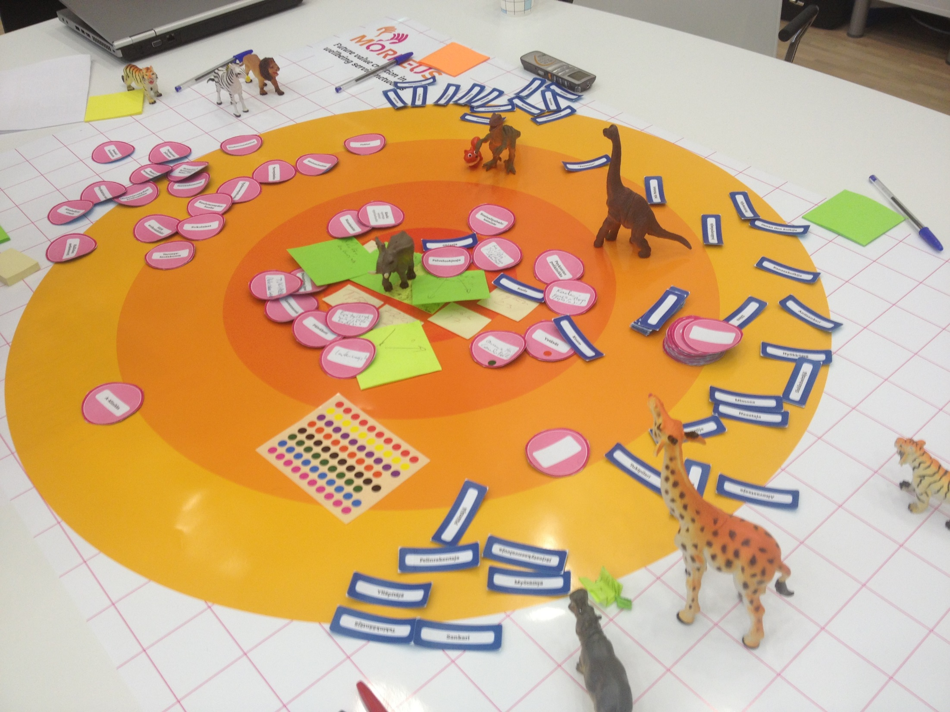
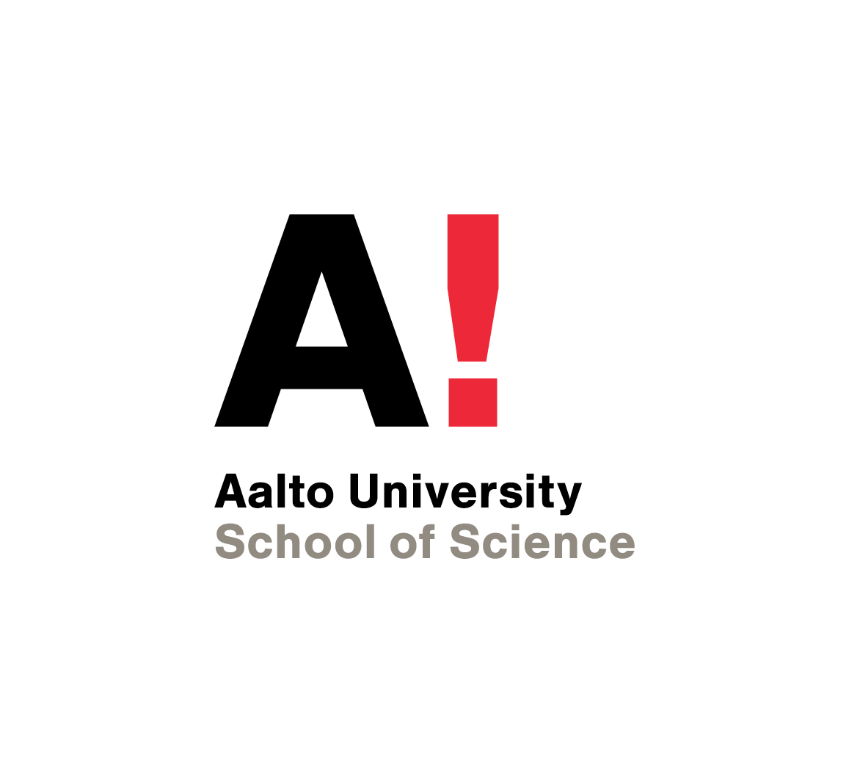



MORFEUS - Discussing Working Seminar
September 15, 2015 at 10:00 – 13.00
Introducing participants
MORFEUS and SimLab (Soile Pohjonen)
Preface presentations:
Tim Cummins, IACCM
Anne Kokkonen, Rita Lavikka, Teemu Lehtinen, CoCoNet
Discussion
Contracting and Collaboration
in Inter-Organizational Business Processes
Digital facilitation tools

Slide 2
- Future value creation in wellbeing service networks
(01/01/2015–30/6/2017) The joint multidisciplinary project of
Aalto University and Laurea University of Applied Sciences and 14 partners
Studies and develops wellbeing services’ multi-actor ecosystems.
An action research and Proactive Contracting approach,
service design, information modeling and future studies.
Actors of the ecosystem are mapped,
the relations between them explored,
especially in mental health, child protection and substance abuse related services.
The main research problem of the project is how cross-organizational collaboration
can be facilitated when developing customer-centered wellbeing service ecosystems?
The project develops Service Information Modeling (SIM)
for service domains
all information required for the procurement and production of a service will be collected there.
clarifies roles, relations and information needs of the actors
strives to enable the development, production and procurement
of more (cost-)effective and client-oriented services in the future.
Based on SIM it will be possible to develop novel digital tools
to support the functioning of the wellbeing service ecosystem.
The first draft of the idea of SIM in the MORFEUS research plan

Slide 3

SIM - digital tools – contracting design
SIM enables proactive self-direction and Systems Intelligence
The big picture: purpose, roles, connections
Detailed information in an user-friendly way
Support (answers to questions)
Developing ideas (presenting and commenting)
What kind of contracting enhances
Self-direction
Systems Intelligence
Proactivity?
From command and control
towards framing and enabling innovative collaboration
Self-directive teams need supportive structures

Slide 4
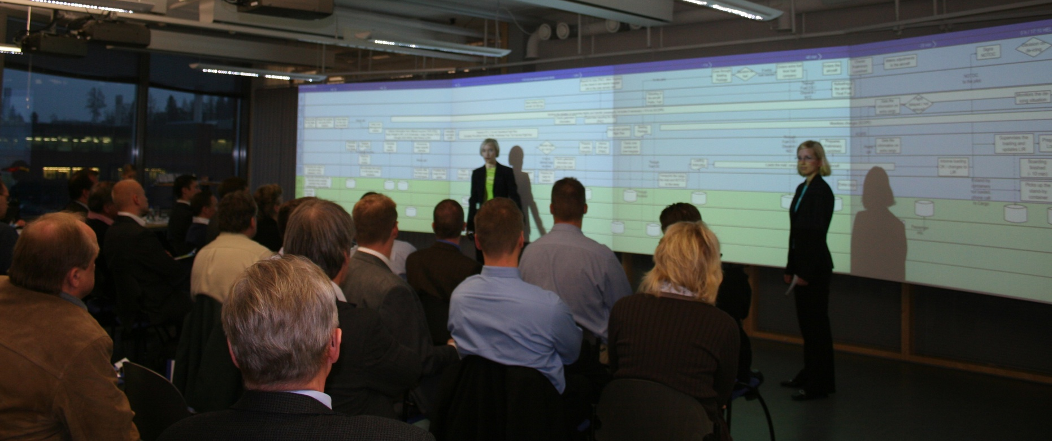

SimLab at Aalto University
SimLab™
Business Process Simulation
Interventions for the development of collaboration in business networks
Research pilots 1998 -
  Analysis and visual map of the process
  Structured and directed process discussion with
  case project examples
  Participation: all process actors involved
  From tacit to explicit knowledge
  Knowledge sharing and co-creation in team work
  Demand-supply processes
  R&D processes
  CRM processes
  HRM processes
  E-Learning and knowledge management processes
  Strategy processes
  Urban planning processes
  Outsourcing and procurement processes
  Public-private service processes
  Business co-creation processes
  … and the related business models
  Current industrial sectors
  ICT, software, construction, manufacturing, education, education, municipal services, media, cross-industrial …
Aalto University
ABB Industry
Ahlström
Asuntosäätiö
City of Espoo
City of Helsinki
City of Hämeenlinna
City of Kauniainen
City of Pudasjärvi
City of Rovaniemi
City of Tampere
City of Turku
City of Vantaa
Consolis Oy
Cramo Instant
Destia
Finnmap Consulting
Ericsson
Elektrobit
Elisa Communication
Finnish Savings Banks Ass.
Finnair
Granlund
Hewlett-Packard
IBM
Instrumentarium Oy Datex
Itella Oyj
Kemppi Oy
KONE Oyj
Lappset Group
Laurea
Martela Oy
Microsoft Oy
Neles Controls
NCC
Nokia Mobile Phones
Nokia Siemens Networks
Nokia BI
Nokian Tyres
Orion Pharma
Patria
Rammer
Radiolinja
Rautaruukki Oyj
Raute
Reuge Music S.A.
RYM Oyj
Samlink
Senate Properties
Sodexho
SRV
Tamrock Oy
Tekla Oy
TKK
TeliaSonera Finland
Tellabs Oy
Tocoman Services
UPM Oyj
Vahanen Oy
Valmet Oy
WSOY Oy
YIT Oy
Yle
…
Multidisciplinary research and teaching unit founded in 1998
Aalto SCI, Department of Industrial Engineering and Management
Research area
Business co-creation and transformation in value networks
  Collaborative innovations in business and service processes and models
  Developmental intervention methods of SimLab™, face-to-face, and virtually
Teaching in the Master Programmes of Information Networks and IEM
  Understanding and managing business as networked processes
  Managing process co-development interventions
  Facilitating inter-organizational process co-creation
  Intervention research methods
Multidisciplinary research group
Industrial Management, Computer Science, Design, Economics, Social Sciences, Communication, Law
Professor, Senior university lecturer, 3 post doc researchers, 7 Doctoral students, Master’s students, project planning officer
Notes:
4

Slide 5
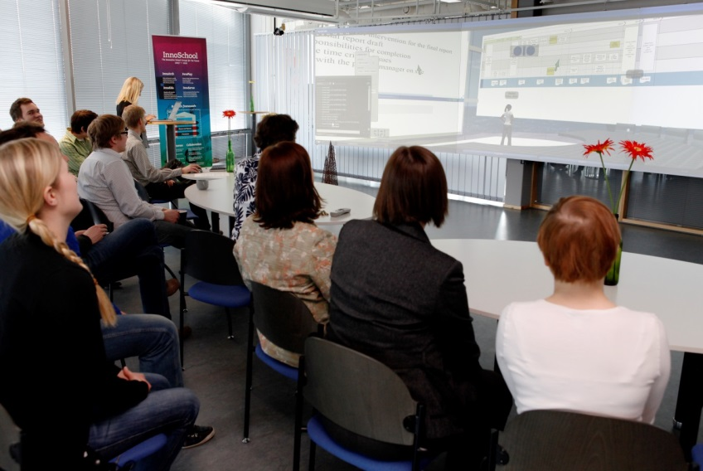
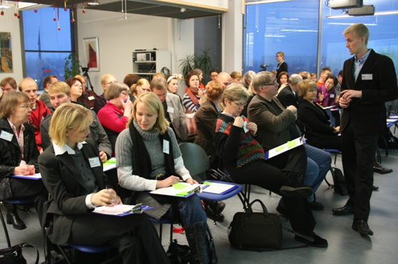
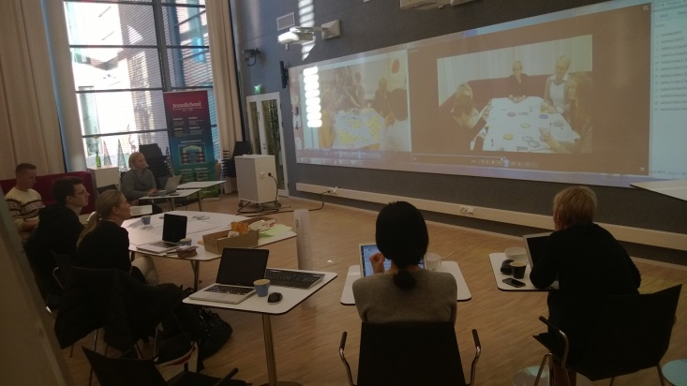
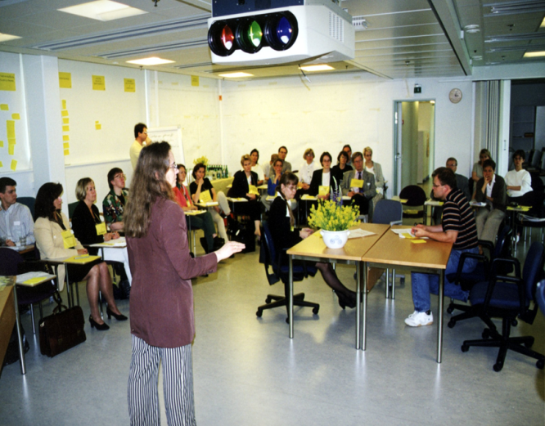
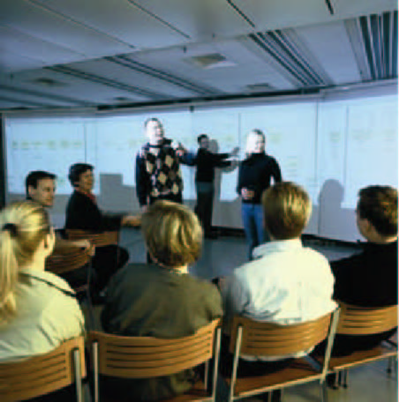
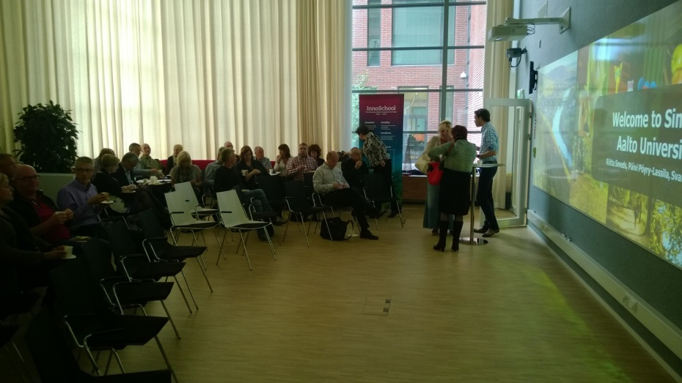
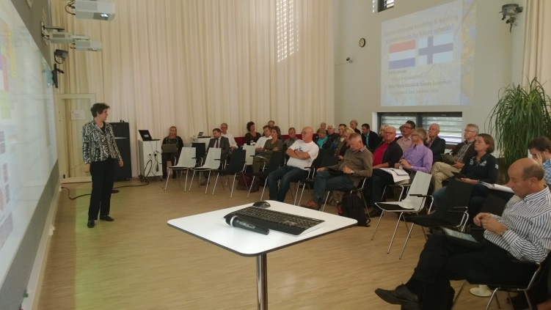
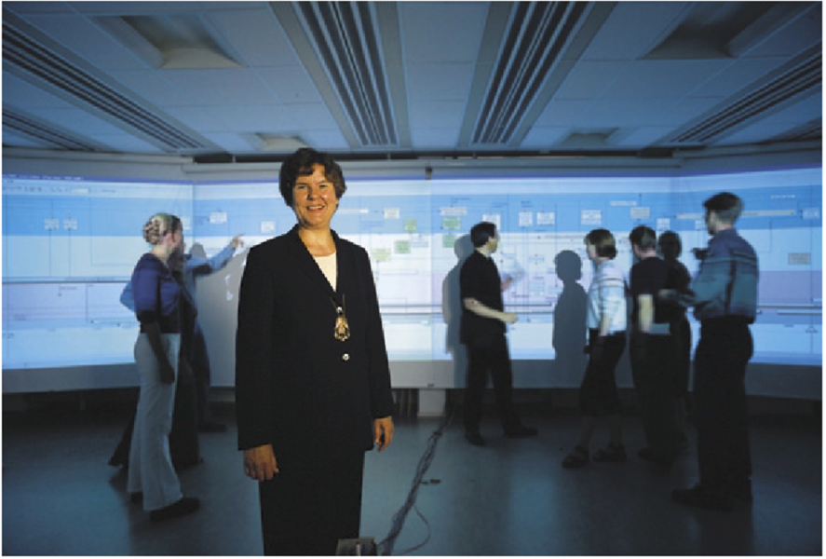
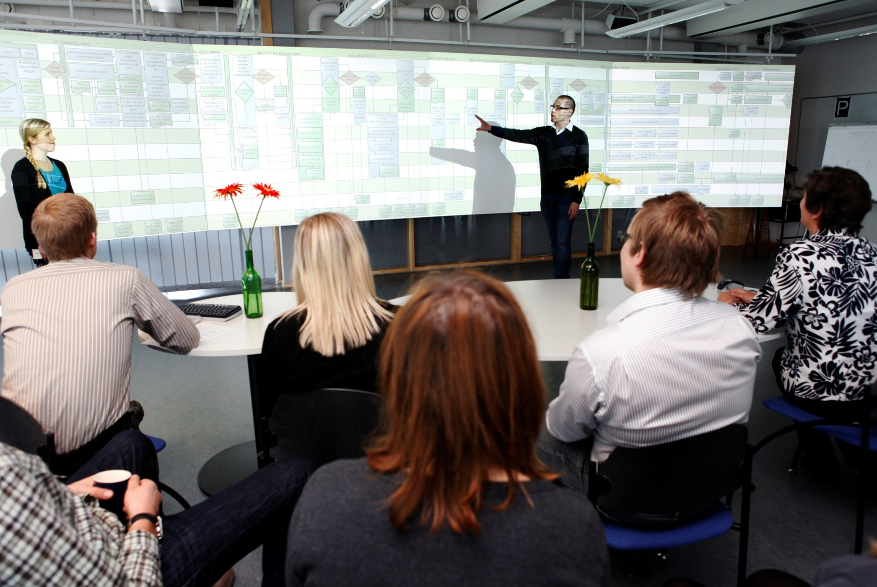
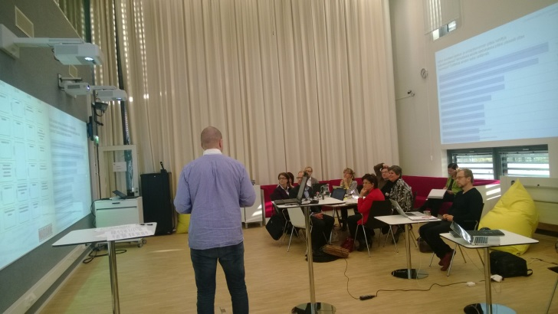
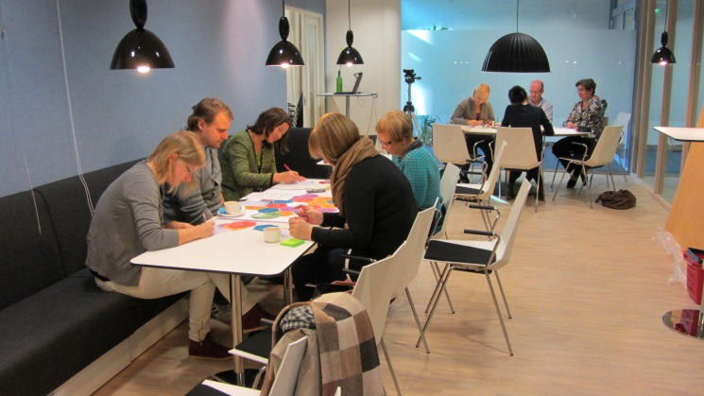
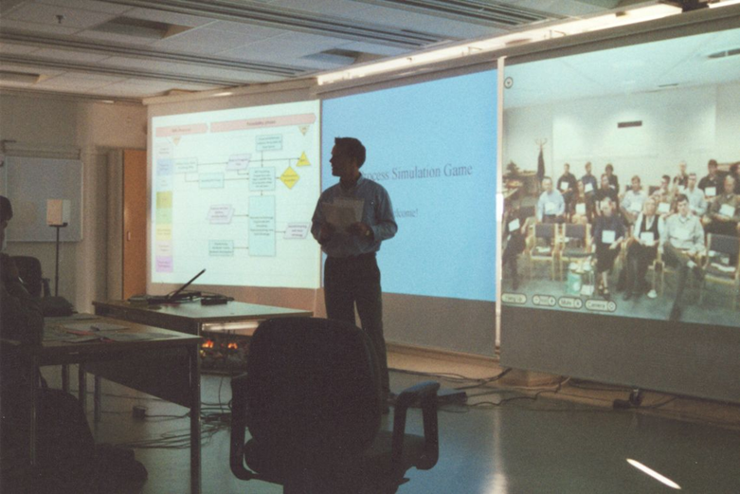
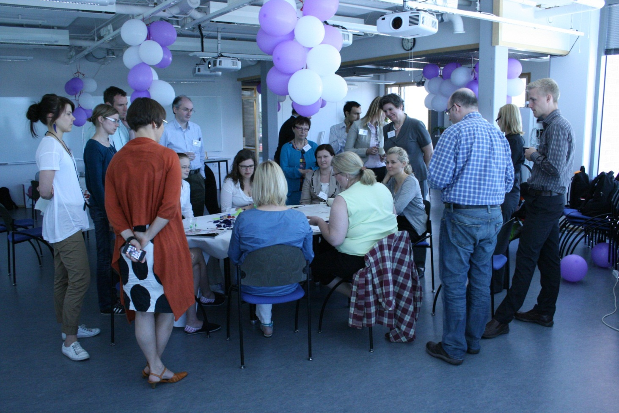
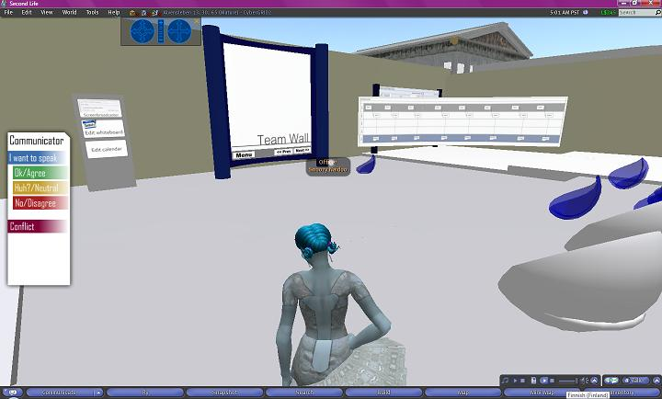
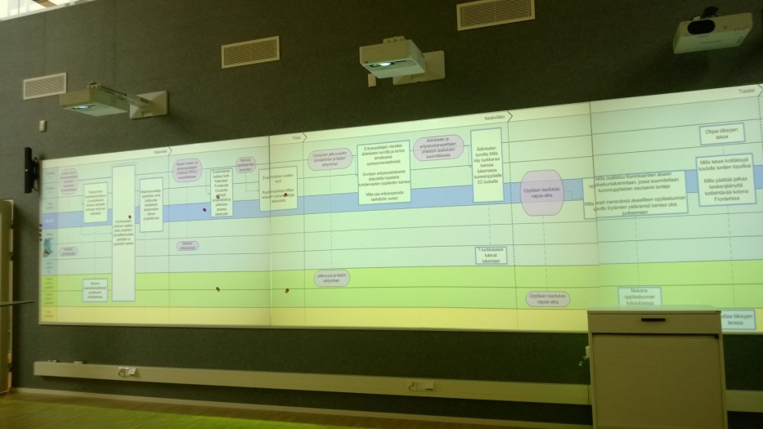
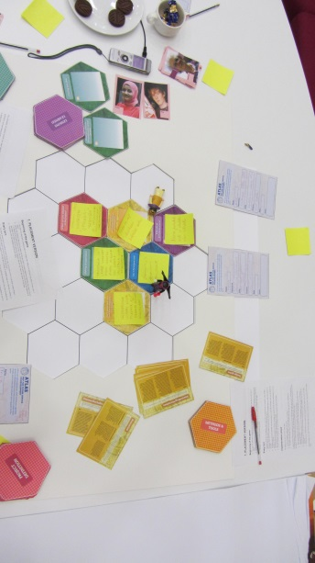
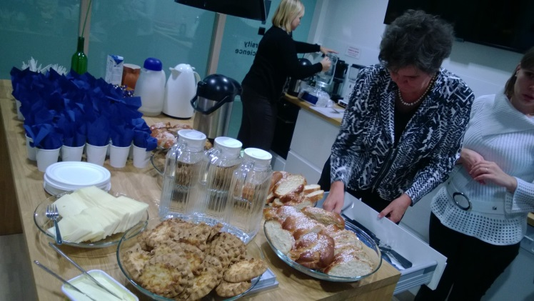
Continuous innovation in SimLab’s collaborative intervention spaces and methods
Since September 2013 in Open Innovation House
1998-2004 in Spektri
2004 – 2013 in Innopoli

Slide 6
SimLab’s triple helix:
interventions, research and teaching
Evolving research themes
The research strategy supports the triple helix
Current research projects
Individual simulation project
Networked
projects
Portfolio of industrially and socially relevant long term research projects, in collaboration with leading companies and public sector partners
  Main funding through Academy of Finland, Tekes, EU, and partners
with ambitious scientific goals, often in collaboration with international top universities, publishing in scholarly journals
  Organization Science, Organization Studies, IJTM, PPC, Supply Chain Management, Project Management Journal, European Journal of Innovation Management, Construction Management and Economics,…
closely linked with teaching on Master’s and Doctoral levels, using research projects as platforms of teaching
  Since 2001: 78 Master’s, 5 Licentiate’s and 10 Doctoral Theses
Context:
Transforming
and emerging
business networks,
ICT as driver
Networked
organizations
Networked
ICT-systems ad services
”Kick-off”
Process
modeling
Interviews
Preparing
the
simulation
Simulation
Day
Analysis of
results
Debriefing
and
feedback
Companies,
Society
MARIANNE 2013-15: Methods and Environments to Enhance Collaborative Innovation in Service Networks. Technology Industries of Finland Centennial Foundation. Research collaboration with HIIT.
CoCoNet 2013-2015: Co-creation and Coordination in Emerging Value Networks – the double role of ICT-enabled modeling tools and methods. Academy of Finland.
CECO 2014-15: Creative Ecosystems and Collaborative Operators. A pilot study in the digital media industry. Tekes Innovation research program, Yle, City of Helsinki, Open Tampere.
MORFEUS 2015-17 Future value creation in the welfare service network. Consortium project with Laurea. Tekes, Municipalities, Healthcare and welfare organizations, ICT companies
…
Structure and coordination
Business models
and processes
Integration of processes
and ICT
Business co-development and learning in value networks
Contracts
Business models
Empirical data collection
Research approach
Action research interventions for collaborative development
Theoretical lenses:
Knowledge co-creation,
Co-design,
Co-learning
Knowledge sharing and co-creation across boundaries
Several simulation projects
Students,
Scientific
community
Facilitation
Boundary objects
Co-creation methods
Research: Action research, case studies, surveys; Qualitative and Quantitative methods; Publications
Teaching: Assignments; Master’s, Licentiate’s, Doctoral Theses
Design of intervention processes
Video analysis of interaction
Face to face and in virtual space
Co-creation and transfer of scientific knowledge

Slide 7
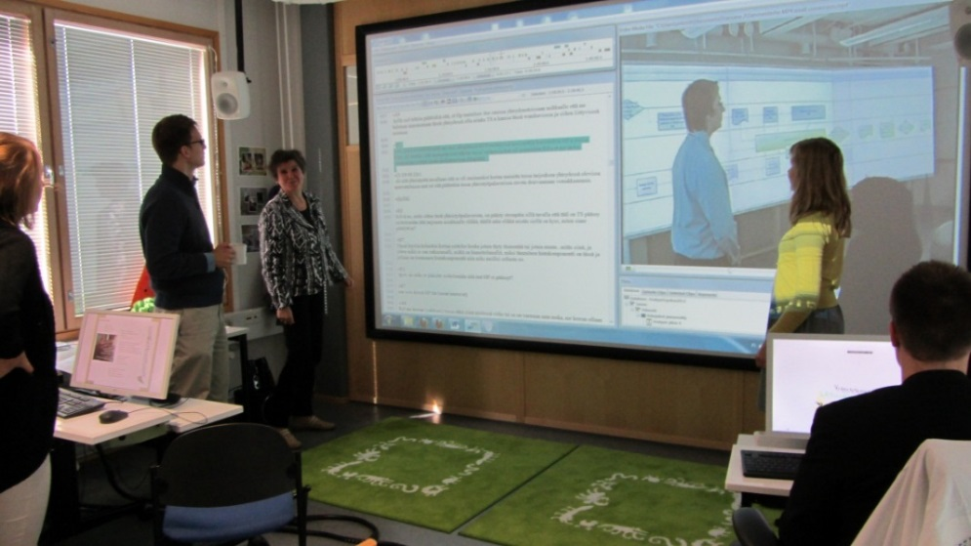
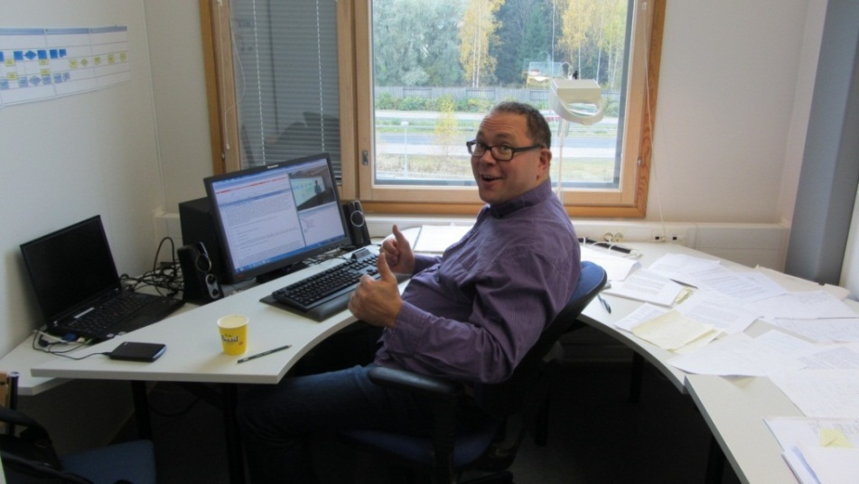
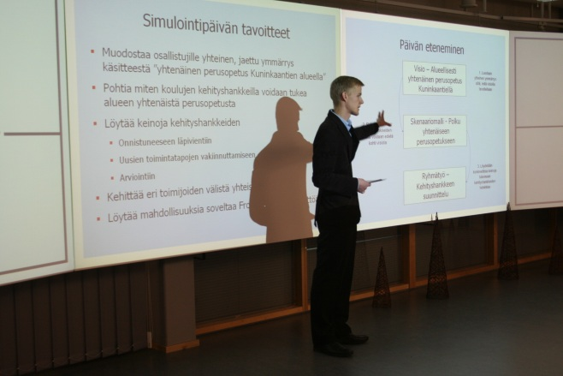
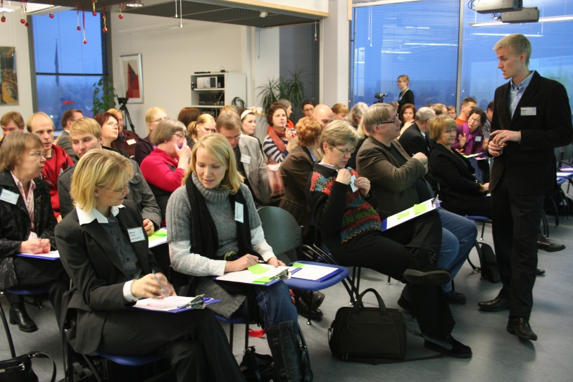
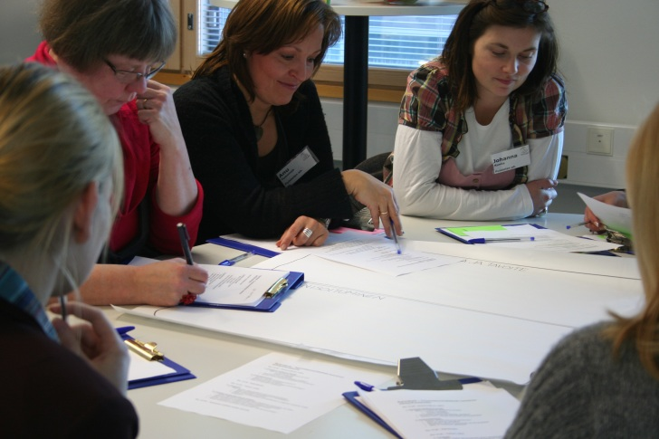
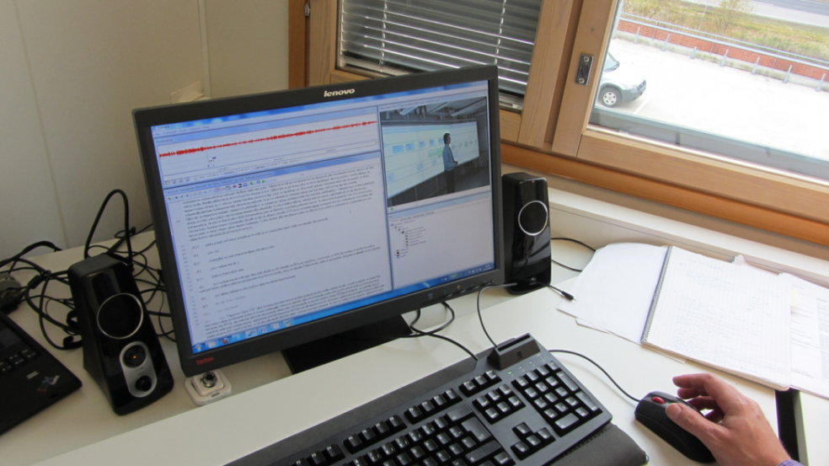
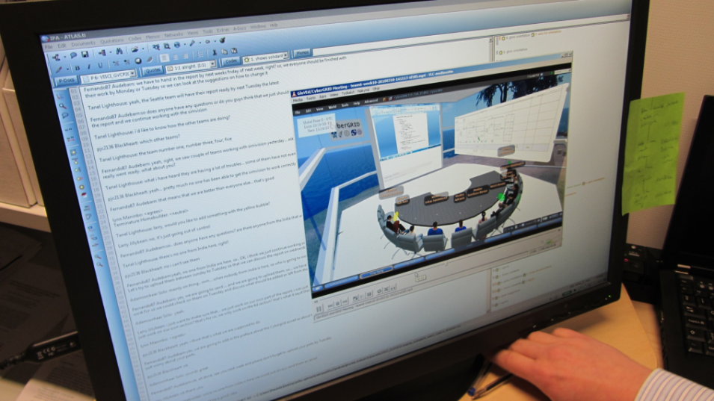
Researchers facilitate the interventions
Researchers collect and analyze the intervention data to create / test theory
Recent publications
Alin, P., Taylor, J.E. & Smeds, R. (2011) Knowledge transformation in project networks: A speech act level cross-boundary analysis. Project Management Journal 42(4): 58-75 (Winner of the 2012 Project Management Journal Paper of the Year Award)
Feller, J., Parhankangas, A., Smeds, R. & Jaatinen, M. (2012) How companies learn to collaborate: The emergence of improved inter-organizational processes in R&D alliances. Organization Studies., Vol. 34, No. 3, 313-343.
Hall, D., Algiers, A., Lehtinen, T., Levitt, R.E., Li, C. & Padachuri, P. (2014) The role of Integrated Project Delivery elements in adoption of integral innovations, In: Chan, P. & Leicht, R. (eds.): Engineering Project Organization Conference 2014. Conference proceedings: Devil’s Thumb Ranch, Colorado, USA, July 29-31, 2014.
Hall, D. & Lehtinen, T. (2015) Agile cost shifting as a mechanism for systemic innovations, In: Chan, P. & Leicht, R. (eds.): Engineering Project Organization Conference 2015. Conference proceedings: University of Edinburgh, Scotland, June 24-26, 2015.
Hirvensalo, A. (2015) Inter-organizational knowledge creation during conflict of interest - a study of interaction in a facilitated workshop (In Finnish). Aalto University publication series DOCTORAL DISSERTATIONS 45/2015.
Jarvenpaa, S.L. and Wernick, A., (2011). Exploring Paradoxical Tensions in Open Innovation Networks, European Journal of Innovation management, 14 (4) Fall 2011, 521-548.
Jarvenpaa, S.L. and Wernick, A., (2012). Open Innovation Networks: The Evolution of Bureaucratic Control, Chapter 2, Collaborative Communities of Firms: Purpose, Process, and Design, edited by Snow, C.C., Information and Organization Design Series, Springer
Kohonen-Aho, L., & Alin, P. (2015) Introducing a video-based strategy for theorizing social presence emergence in 3D virtual environments. Presence: Teleoperators and Virtual Environments, 24(2).
Kokkonen, A. & Alin, P. (2015) Practice-based learning in construction projects: a literature review, Construction Management and Economics.
Kokkonen, A. & Alin, P. (2015) Collaboration in construction projects: investigating cross-boundary participation in colocation, Conference paper, EGOS 2015, Athens, Greece, July 2-4, 2015.
Lavikka, R., Smeds, R. & Jaatinen, M. (2009) Coordinating the service process of two business units towards a joint customer. Production Planning and Control. Special Issue. vol. 20, no. 2, pp. 135-146.
Lavikka, R., Smeds, R. and Jaatinen, M. (2015) Interventions for managing ambidexterity in inter-organizational collaboration processes, Business Process Management Journal, Vol 21, No. 5.
Lavikka, R., Smeds, R. and Jaatinen, M. (2015) Coordinating collaboration in contractually different construction projects, Supply Chain Management: An International Journal, Vol. 20 No. 2. pp. 205-217.
Maunula, A., Taylor, J.E., Alin, P. and Smeds, R. (2013) Aligning Misaligned Systemic Innovations: Probing Inter-firm Effects Development in Project Networks. Project Management Journal, Vol. 44, No. 1, 77-93.
Paananen, H., Irrmann, O. and Smeds, R. (2013) “Perceived Proximity and Paradoxical Tensions in an Innovative Industry-Academia Consortium. Proceedings of the 46th Hawaii International Conference on System Sciences (HICSS), January 2013, Hawaii (USA)
Salmi, A.; Pöyry-Lassila, P.; Kronqvist, J. (2012) Supporting Empathetic Boundary Spanning in Participatory Workshops with Scenarios and Personas. International Journal of Ambient Computing and Intelligence, Vol. 4, No. 4, pp. 21-39.
Before the simulation:
Collect and analyze the data
Design the process model and other boundary objects
Co-develop the objectives for the simulation
Prepare the manuscript
In the simulation:
Put questions
Encourage the dialogue
Organize group work on critical points
Manage the schedule
Observe and collect the data
Each intervention produces a wealth of data
Interview recordings and transcriptions
Video and audio recordings of the dialogue during the intervention day
Observations of the intervention day
Observations from the intervention project
Documentary data from the participant organizations
Follow-up interviews as audio recordings and transcriptions
Surveys
The data is analyzed applying multiple methods and theoretical lenses
Content analyses of the observations and interviews
Content analyses of the video recordings
  Visual analyses of the data
Comparative analyses across several intervention projects
Quantitative survey analyses

Slide 8

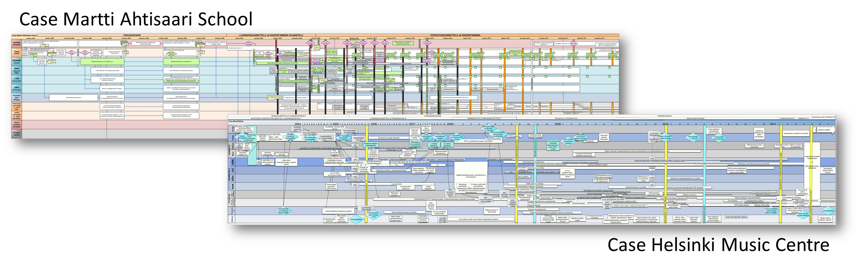
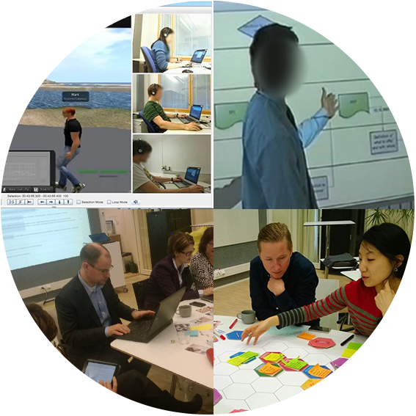
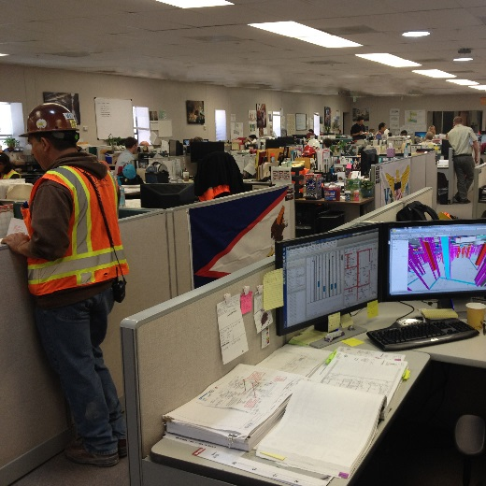

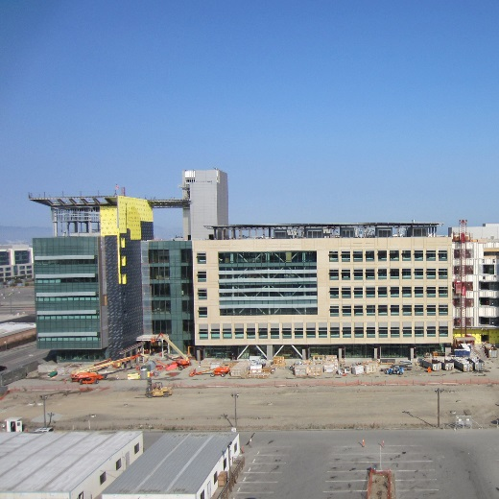

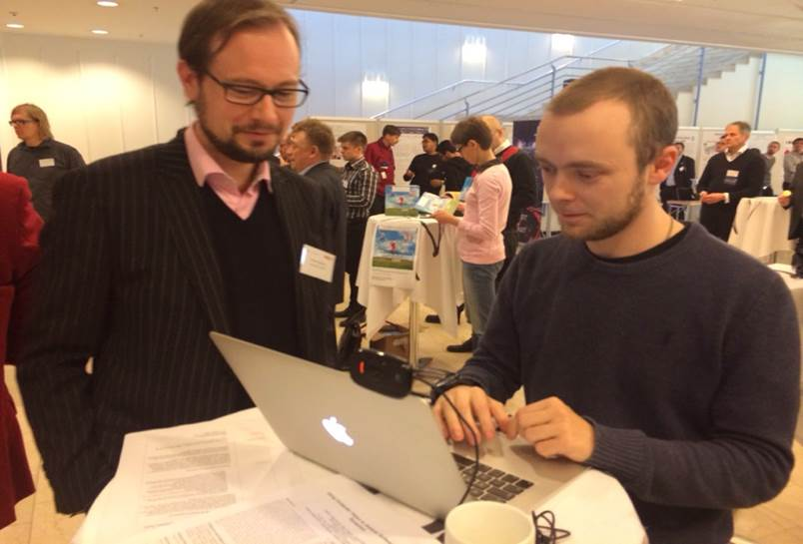
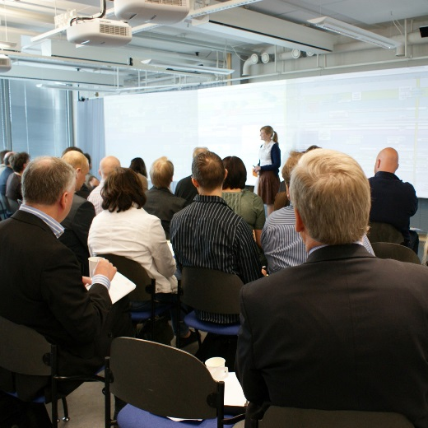


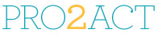
Project management and process innovation in construction
Proactive contracting and
inter-organizational processes in services
Emerging
Business Ecosystems
Facilitation and knowledge co-creation
Virtual collaboration
Communicating social presence in virtual teams
Avatar-based interaction in 3D environments
Role of verbal and non-
verbal communication
AivoSenses project/Laura
Face-to-face knowledge creation
Knowledge creation in inter-organizational context
Co-creation of collaboration practices
Facilitator’s activity in guiding interaction
Facilitation project
/Antero, Miia
Practices of managing collaborative innovation
Properties of creative ecosystems
Inter-organizational open strategizing
New Business Model Based on Process Network and Building Information Modeling (BIM). Main research themes are 1) TO-BE BIM process, 2) lean and integrated practices, and 3) contract models.
Starting point: Proactive Contracting, a cross-disciplinary and cross-professional approach to promote successful collaboration and knowledge sharing – to co-create and reach the mutual goals.
Team co-location: Coordinating agile
co-working, space as
a tool for collaborative project management
Integrated Project Delivery: IPD and cross-disciplinary innovations, agile cost shifting
Contracts and contracting processes can become user-friendly boundary objects by
visualizing them and their environments
developing digital tools
BIM process redefined: identification of tasks and intensive collaboration points
Facilitation
ICT-supported
collaboration
Large group participation
“Metagroup” process:
Combination of face-to-face
and ICT-mediated collaboration
MARIANNE project/Elina, Laura
Games in
Knowledge Creation
Artefact-mediated dialogue
Playful co-development of practices
Instrumental play
CECO project/Otso
The main research problem of the ongoing MORFEUS project is how cross-organizational collaboration can be facilitated when developing customer-centered wellbeing service ecosystems. MORFEUS introduces the idea of Service Information Modeling (SIM) which includes contracts.
Co-creation and Coordination in Emerging Value Networks – the double role of ICT-enabled modeling tools and methods. This double role for innovation and efficiency is analyzed from three theoretical domains: 1) collaborative innovation, 2) coordination and integration, and 3) inter-organizational learning.

Slide 9
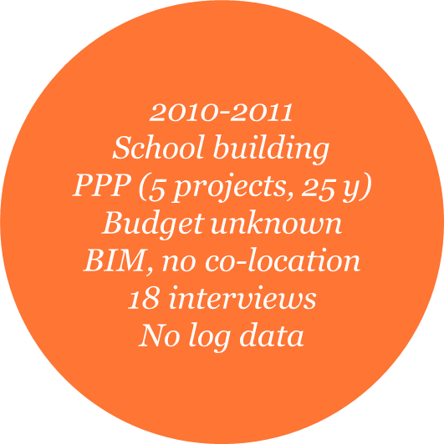
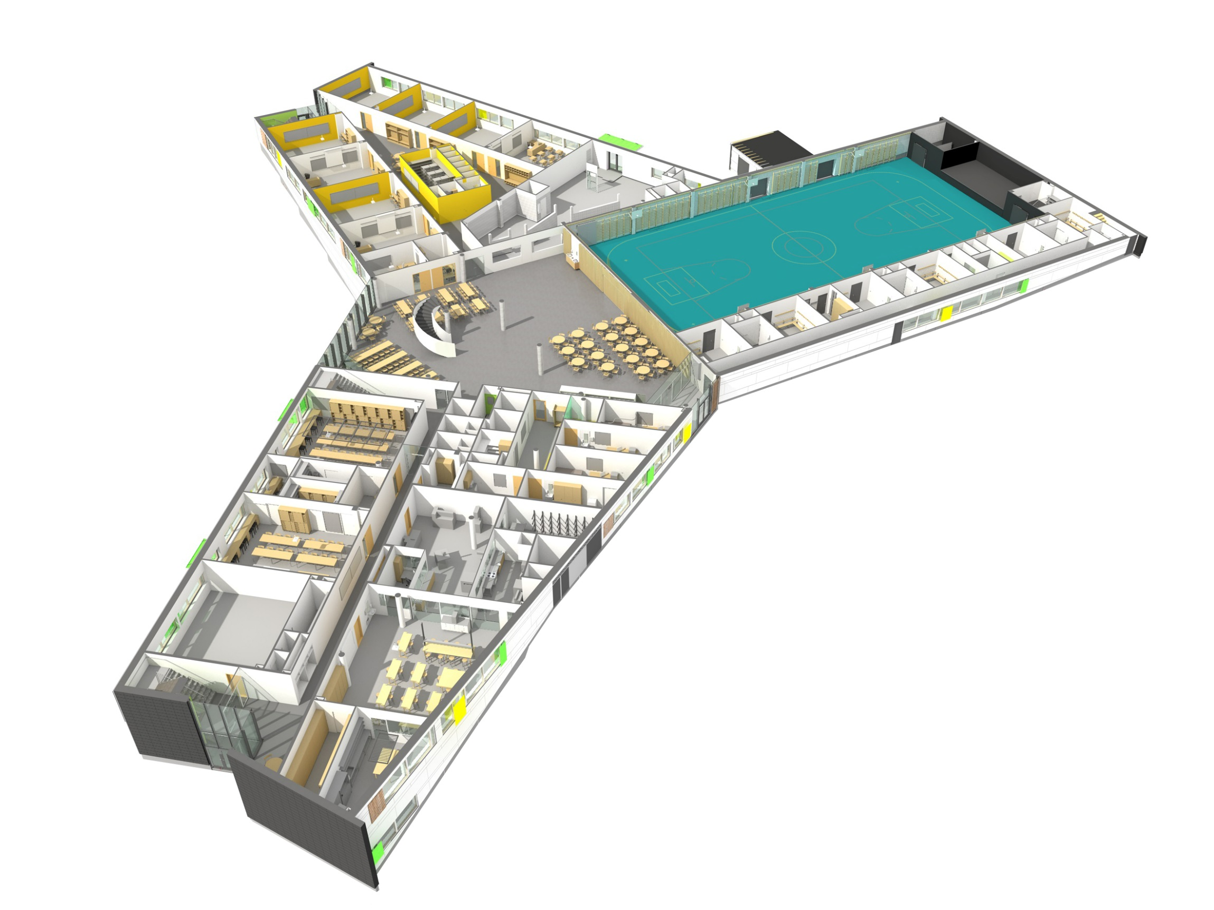
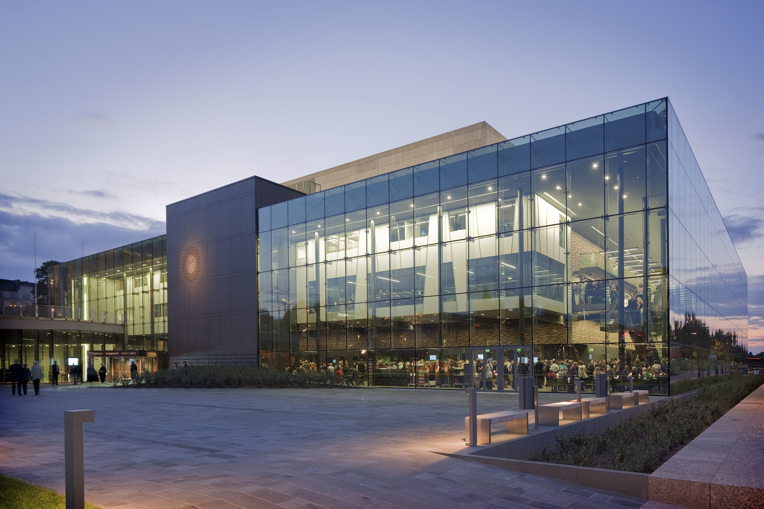
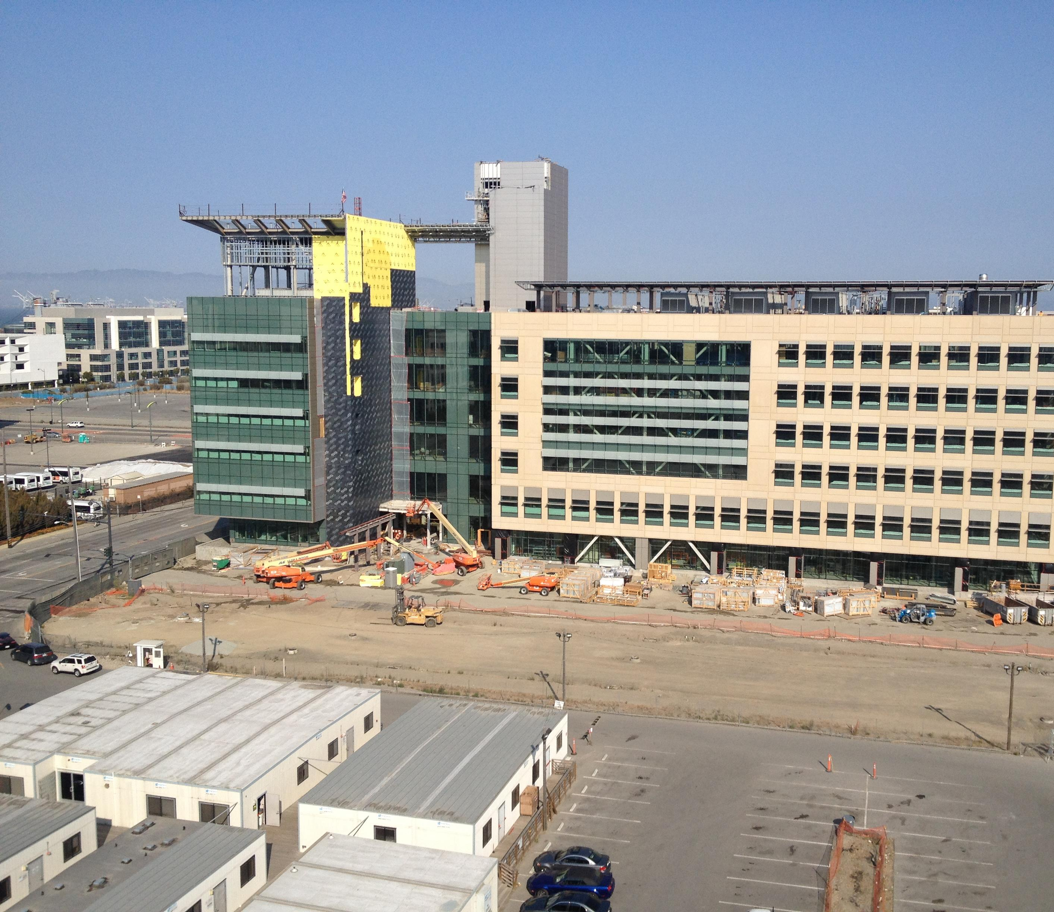
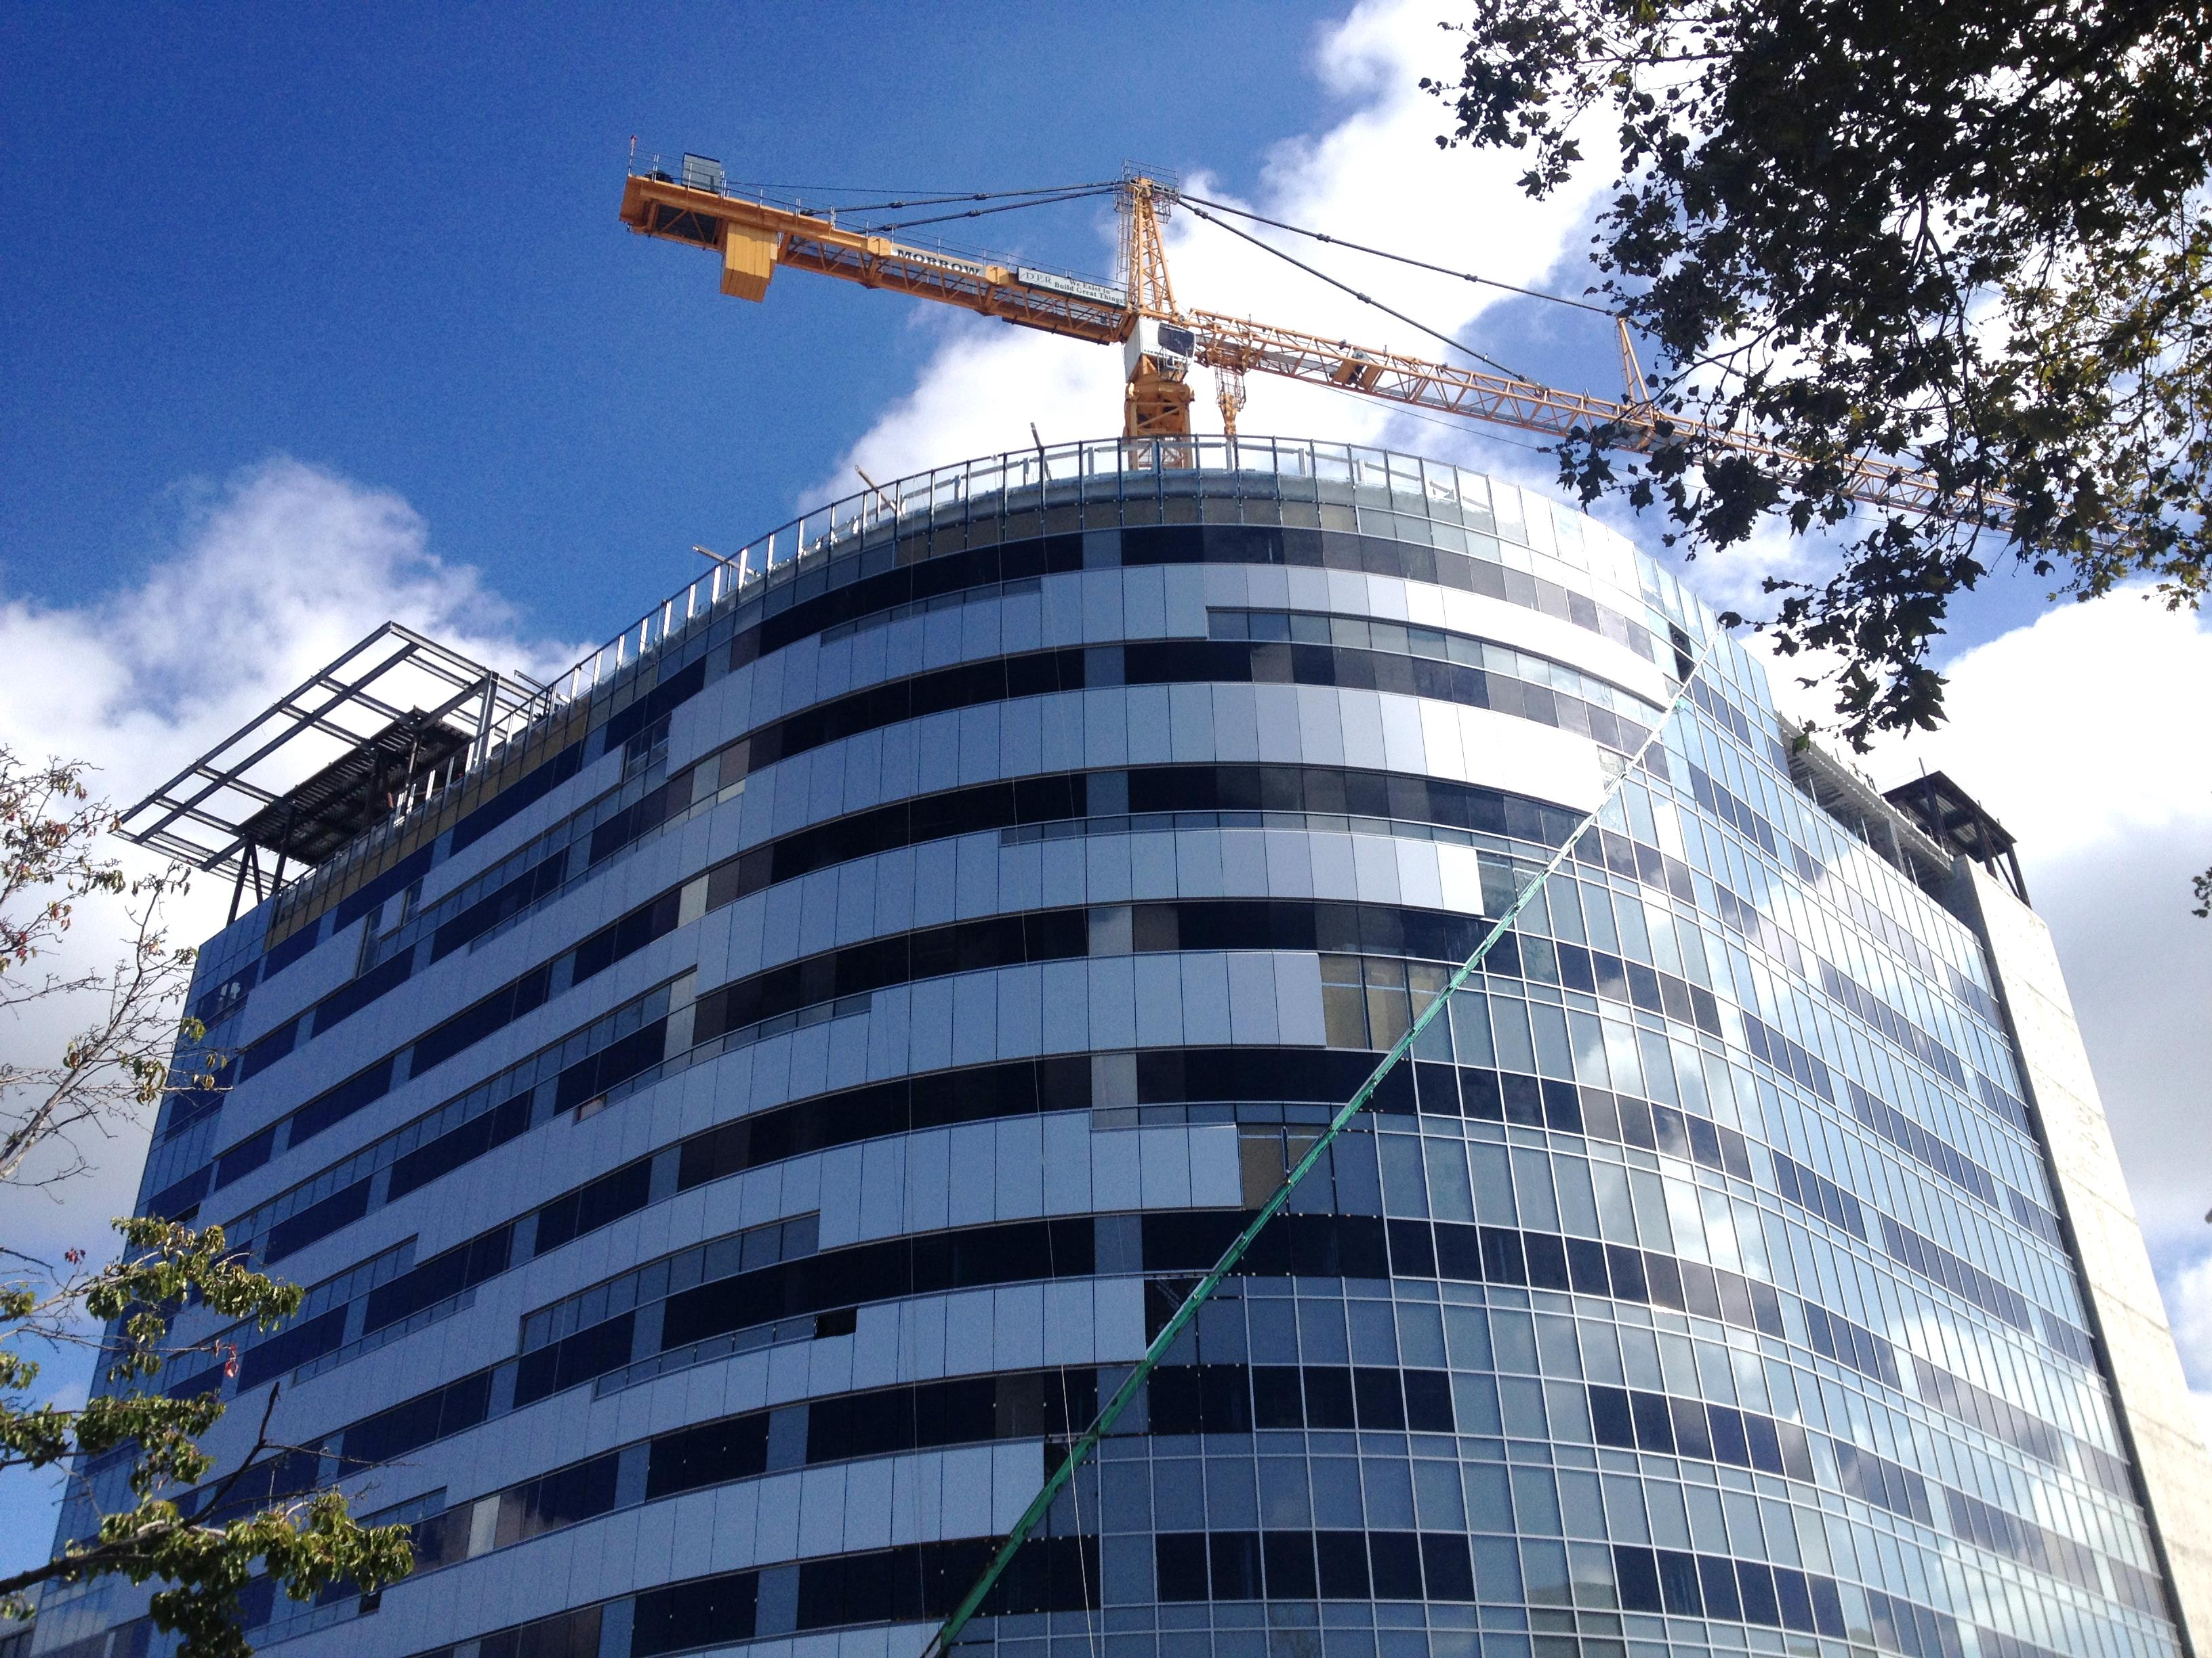
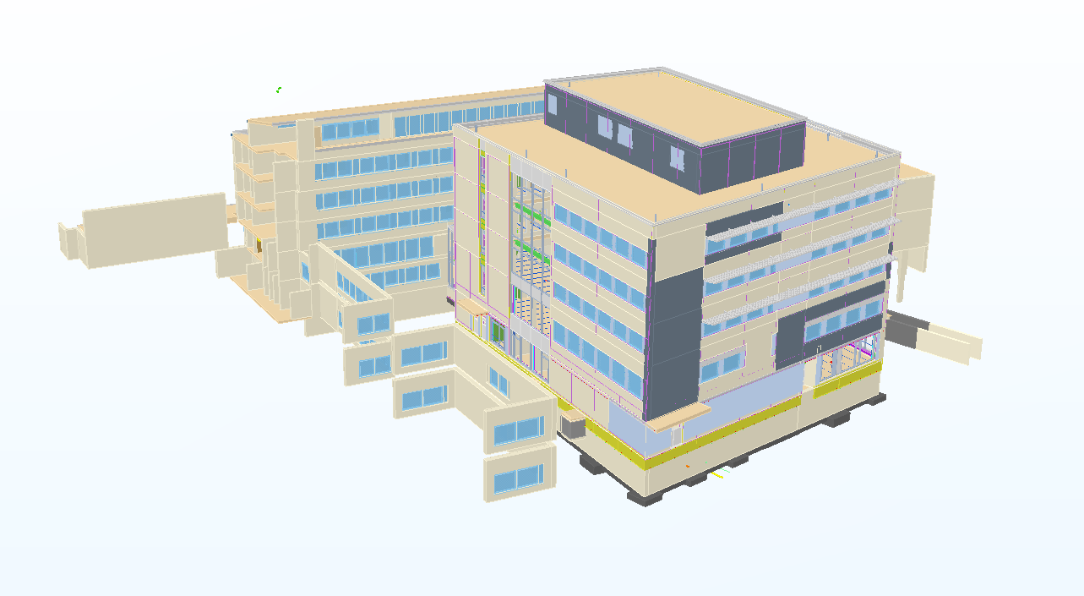
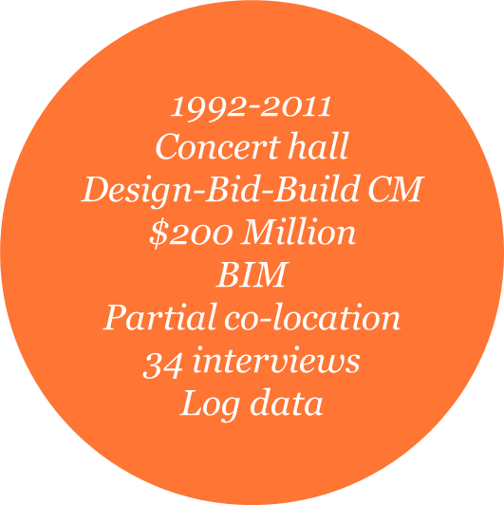
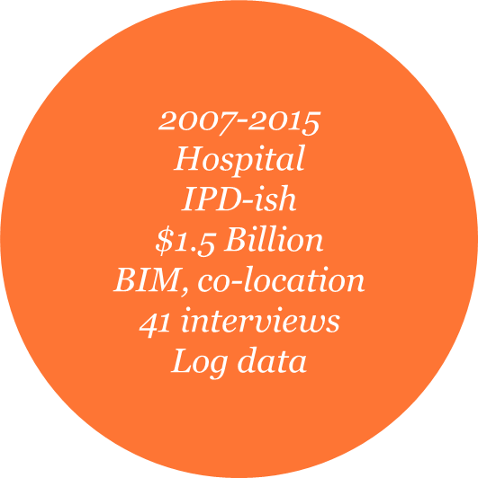
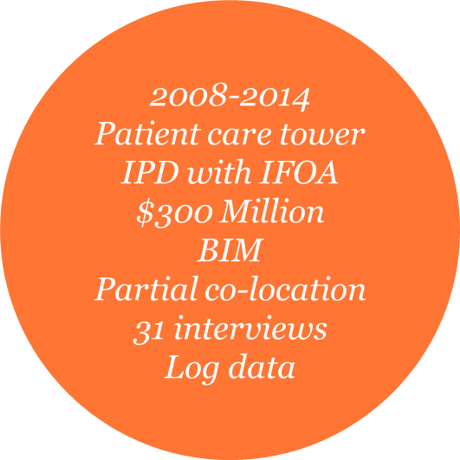
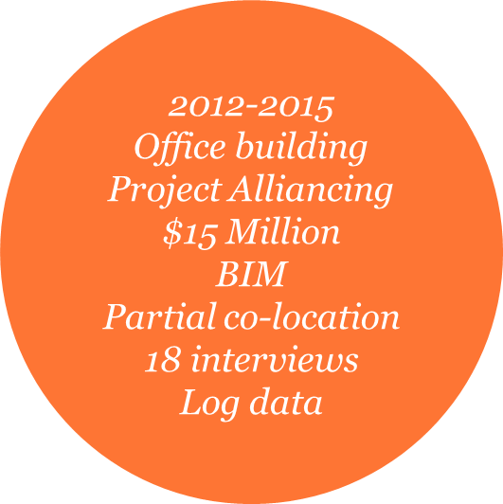






Slide 10
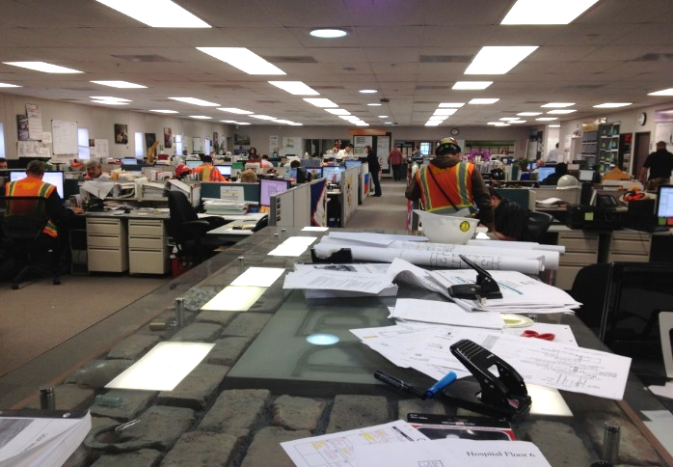

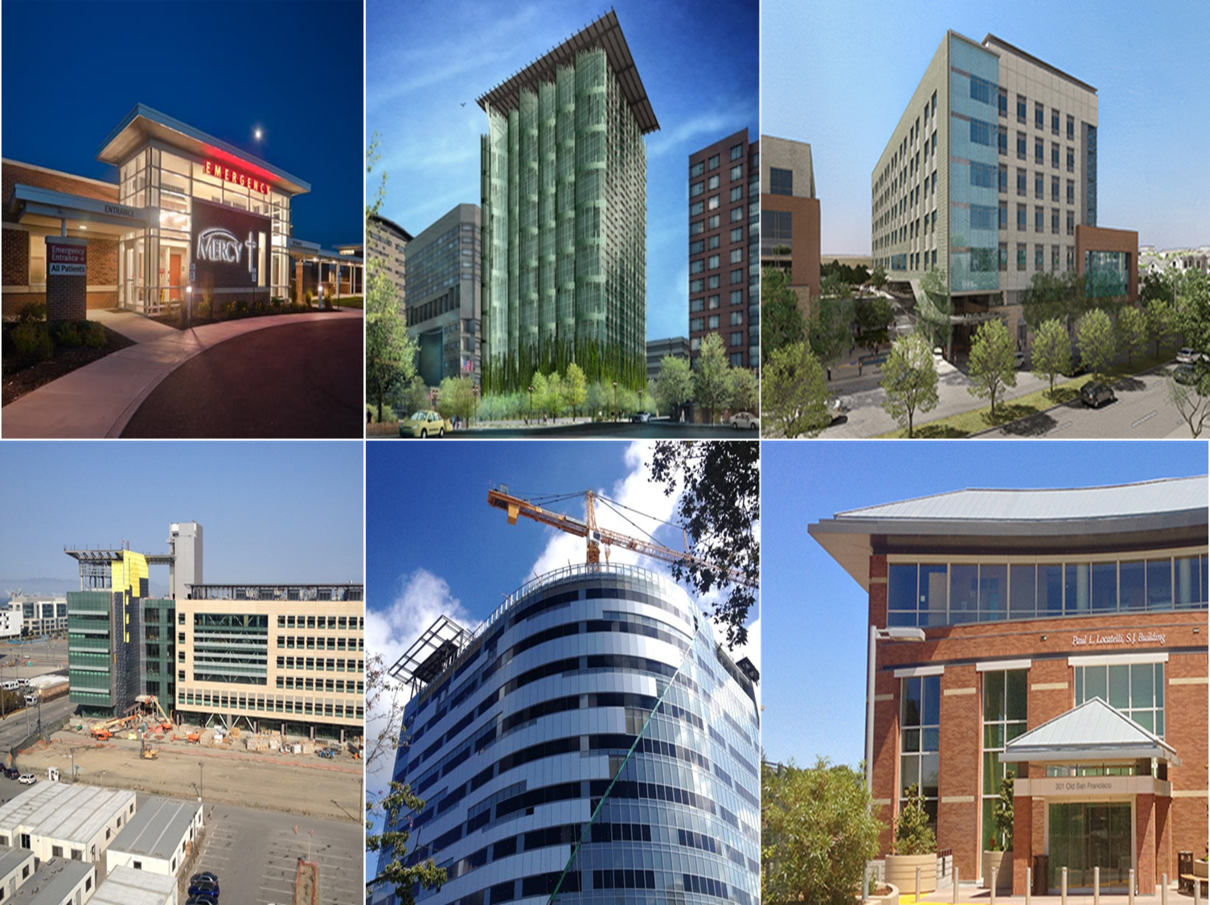
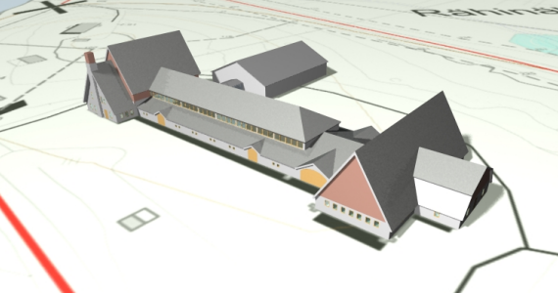
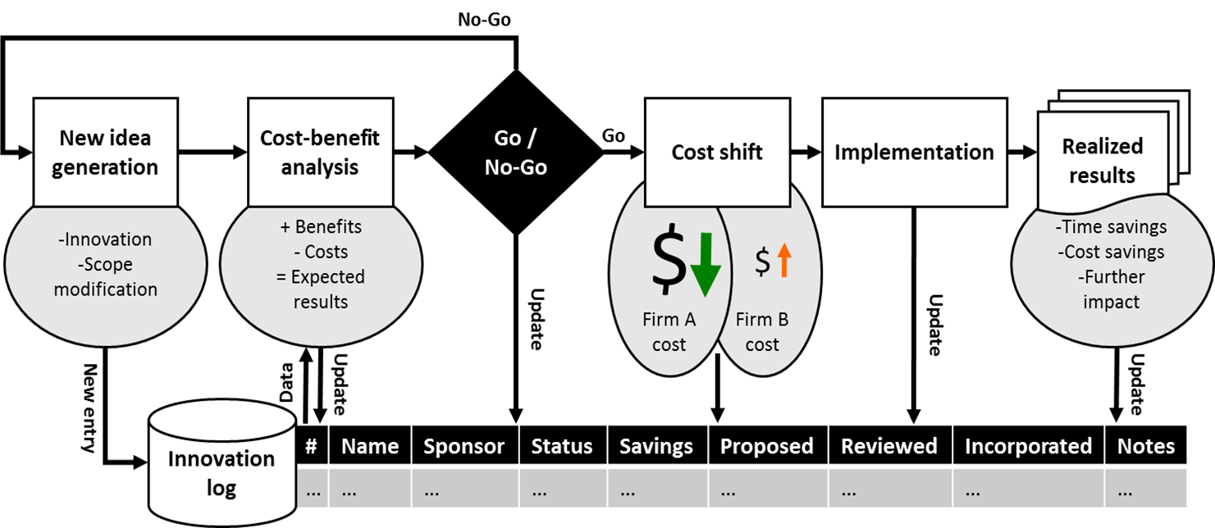
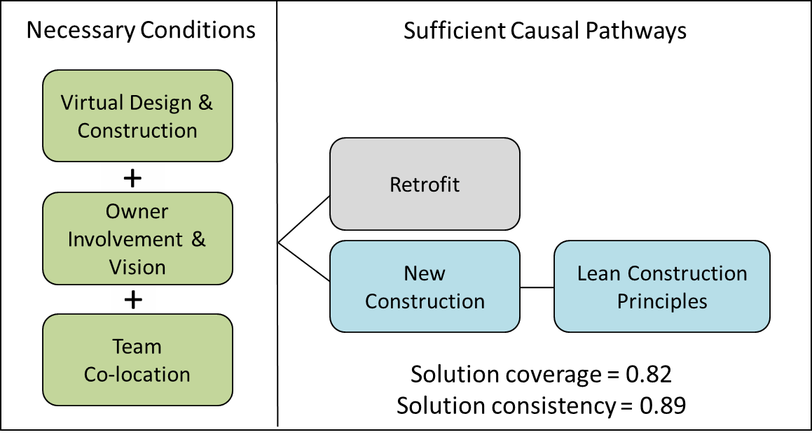
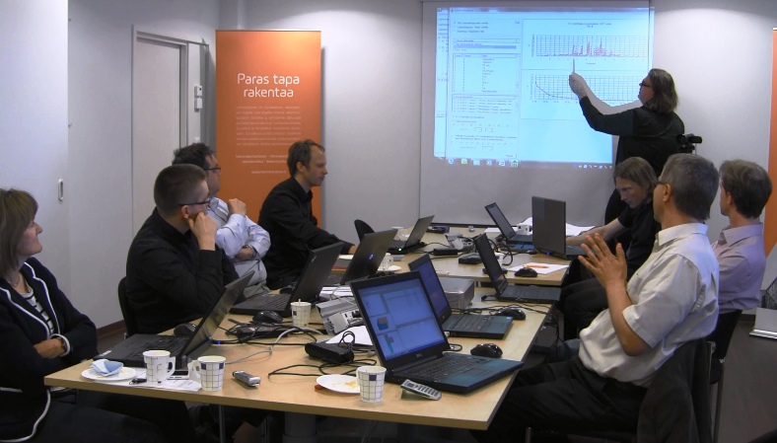


BRINGING THE DESIGN TEAM TOGETHER:
Coordinating inter-organizational design work using an agile co-working method
Space as a tool for collaborative
project management
The role of IPD elements in adoption of
cross-disciplinary innovations
Agile cost shifting as a mechanism for systemic innovations
(Lavikka, Niku, Lehtinen 2013)
(Kokkonen & Alin 2015)
Key findings
Common understanding
The sprint increased common understanding between team members about other disciplines’ work tasks during conceptual design
Commitment
Participants created goals for the project together which increased commitment
Visualization of knowledge
Visualizing the work completed helped in the customer’s decision making
Phase 1
– co-location
One space, floor plan according to teams
Design phase, 100 participants
Phase 2
– co-village
Main trailer and other trailers for subs, companies divided
Construction phase, 200 participants
More face-to-face interaction
Old practices coming back such as emailing
Less face-to-face collaboration
New co-practices implemented
Project team collaboration
Space
Project tasks
Management (strategy, processes)
Interaction practices
fsQCA (Ragin 2009)
Proximity does not automatically increase interaction in a space. Knowledge management processes and interaction practices such as overhearing and interfering in space are also needed.
(Hall, Algiers, Lehtinen, Levitt, Li, Padachuri 2014)
(Hall & Lehtinen 2015)

