Slide 1

Social Services and Health Care in Helsinki
MORFEUS
15.6.2016
Arja Peiponen
Lic.Ssc, MPH, eMBA
Division Director

Slide 2
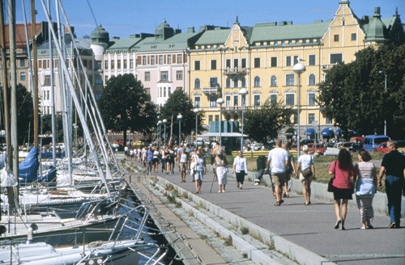
Helsinki residents
624 000 inhabitants
The population grew by 8,000 people
Residents with some other mother tongue than Finnish, Swedish or Sami language 13.5%
1.87 residents/household
25% lived alone
Two thirds of the population were working age
Over 65-year-olds 16%
Under 18-year-olds 16%
Life expectancy of a new born baby
  women 83.5 years
  men 77.8 years

Slide 3
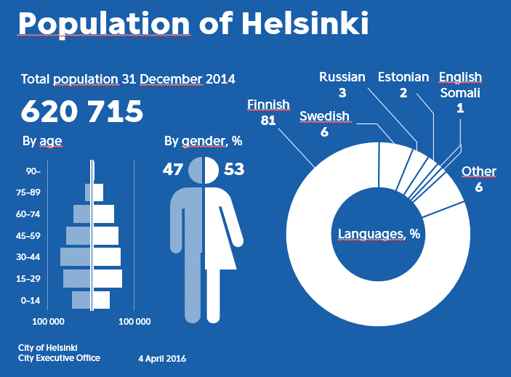

Slide 4
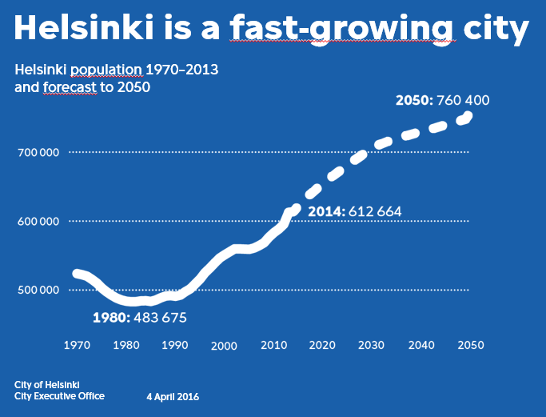

Slide 5
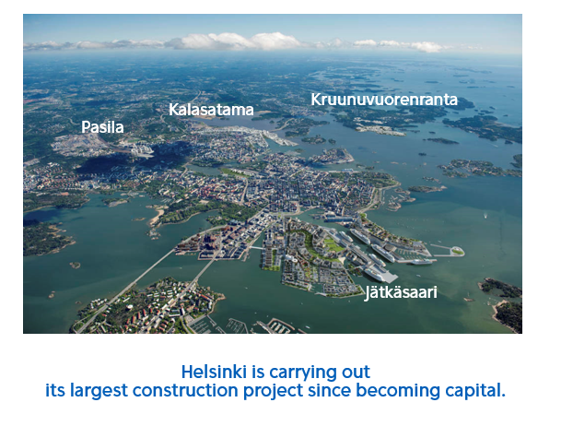

Slide 6
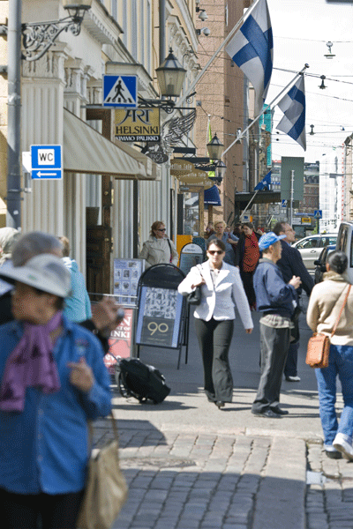
Helsinki's social welfare and health care services in a nutshell
The City organises and primarily produces social welfare and health care services for 624,000 residents
Governed by a political board composed of 13 members
The Department of Social Services and Health Care 1 January 2013 ->
16,000 employees
133 customer service points around the city
Budget EUR 2,2 million (CHF 2,368 million)

Slide 7
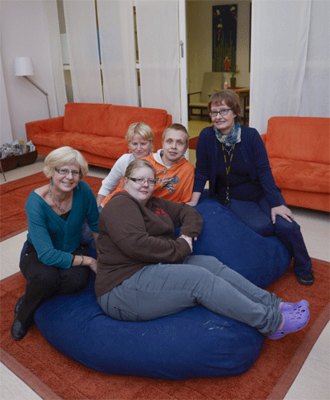
Services 2015
Child Welfare Services’ customers (children) 9,125
Customers of the services for intellectually disabled 2,008
People receiving income support 75,895
Customers of substance abuse outpatient clinic 5,120
Days of service housing for the elderly
1,087,178
Housing service places
(both the city’s and purchased) 3,995

Slide 8
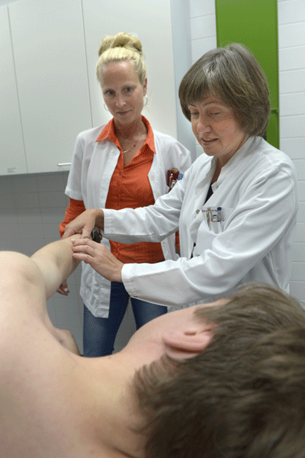
Services 2015
Appointments with a physician 497,764
Treatment calls with a physician 284,402
Appointments with a nurse 405,659
Treatment calls with a nurse 327,438
Emergency service visits 134,182
Dental care appointments 457,869
Home care visits and other
treatment visits 2,809,984
Treatment days of acute treatment 248,415
Visits to the psychiatric
outpatient clinics 154,146

Slide 9
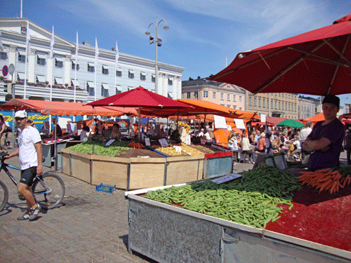
Funding 2015
City of Helsinki 88%
Customers 5%
Others 7%

Slide 10
What are the Department of Social Services and Health Care's funds used for?
(2015 budget, 2014 accounts in parentheses)
Social and health care services MEUR 1,460 (MEUR 1,438)
HUS MEUR 524 (MEUR 527)
Social assistance MEUR 172 (MEUR 176)
Employment MEUR 33 (MEUR 37)
Total MEUR 2,188 (MEUR 2,178)
The Department of Social Services and Health Care accounts for 46% of the City's total budget

Slide 11
SOCIAL SERVICES AND HEALTH CARE COMMITTEE
Head of Department
Juha Jolkkonen
Organisation 2016
First section
Second section
Third section
Human resources and development services
Financial and support services
Family and social services
Health and substance abuse services
Information management and communication services
Hospital, rehabilitation and care services

Slide 12

Department of Social Services and Health Care
Basic duty (mission)
Wellbeing, health and social security for the residents of Helsinki.

Slide 13

Department of Social Services and Health Care
Objective (vision)
The City of Helsinki Department of Social Services and Health Care is the leading operator and reformer of social and health care in Finland.
We encourage the city's residents to take responsibility for their own wellbeing and health, as well as that of their loved ones, and provide seamless help for those who need it.

Slide 14
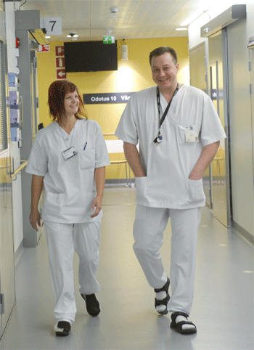
Values
The values of Helsinki:
Resident orientation
Ecological approach
Fairness and equality
Economy
Safety
Involvement and participation
Enterprise-friendliness.

Slide 15
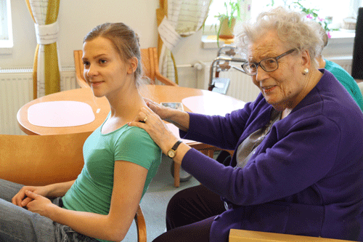
Strategic objectives 2014 - 2016
Service culture reforms
Service is started in the first place of meeting and the customer has a flexible access to the services. “You've come to the right place. How may I help you?”
The continuation of treatment is ensured by renewing the work methods.

Slide 16
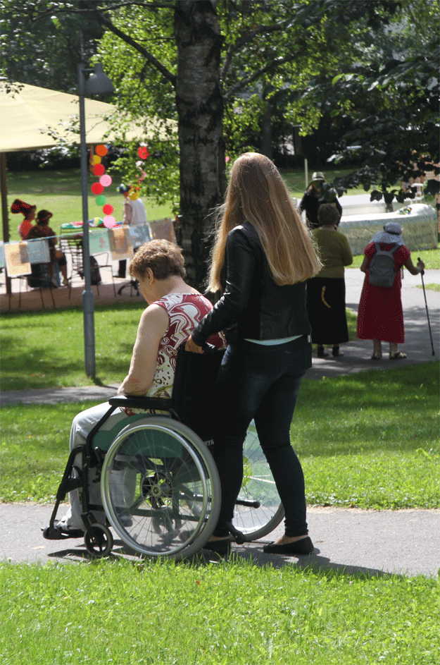
Strategic objectives 2014 - 2016
The health and wellbeing gaps of population groups grow narrower
The assessment of health impacts affects the city’s decision-making.
Smoking and substance use decrease and the number of overweight Helsinki residents reduces.
In regard to wellbeing and health, the underprivileged are the key customers.
The number of young people who have dropped out of education and work life decreases.

Slide 17
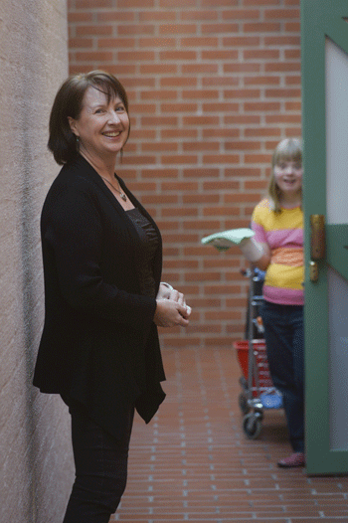
Strategic objectives 2014 - 2016
Integrated services and treatment
Improving the efficiency of service chain for the elderly and those with multiple illnesses.
A resident requiring substance abuse and mental health services can receive an assessment of care needs without having to wait, as well as a treatment plan, treatment, rehabilitation and services in the right place without delay.
A secure housing path for young people living in child welfare service’s institutions.
The integrated support services will help the continuous improvement of service production, development of operations and leading with information.

Slide 18
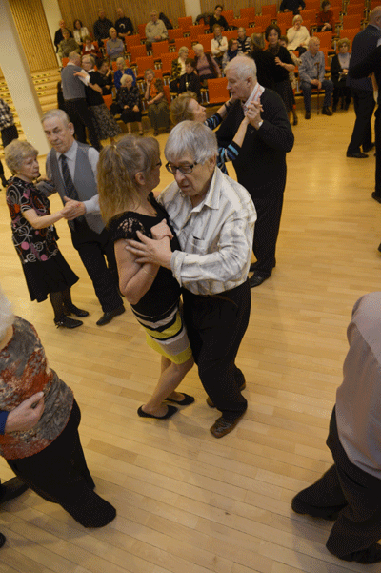
Strategic objectives 2014 - 2016
Lighter service structure
Children and young people receive help within their own close community.
The inpatient periods at hospitals and institutions by customers of mental health and substance abuse services become shorter and repeated inpatient periods decrease.
The home based services and services supporting living at home given to the elderly and those under 65 years of age with weakened functional abilities are increased and institutional care decreases.

Slide 19

Strategic objectives 2014 - 2016
Availability and productivity of services improve
The availability of services improves in accordance with the service promises of the central functions.
The implementation of legislated waiting times is ensured.
The self-treatment and self-care of the citizens and informal care as well as service information and service guidance are reinforced.
The productivity of operations is improved by increasing direct customer work and the number of customers.

Slide 20

Strategic objectives 2014 - 2016
Attractive work communities
Competent and functional work communities.
Optimal personnel structure for customer and patient work.

Slide 21
Current events 1/2
National social welfare and health care reform
  In Finland, social welfare and health care services are currently organised by 317 municipalities
  In the future services will be organised by a maximum of 18 regional management areas
  Financing reform
  Increasing freedom of choice
Successful integration of asylum seekers
  New situation: significant increase in the number of asylum seekers in 2015
New client data system Apotti (based on EPIC system)

Slide 22
Current events 2/2
Integration of social welfare and health care services
  Family centre model
  Health and well-being centre model
  Comprehensive service centres
Cost-effectiveness
  A lighter service structure as the cornerstone of productivity
  Predictive and active definition of service needs and service management
  Services emphasise outpatient care and are cost-effective
  Service management is appealing for patients.

Slide 23
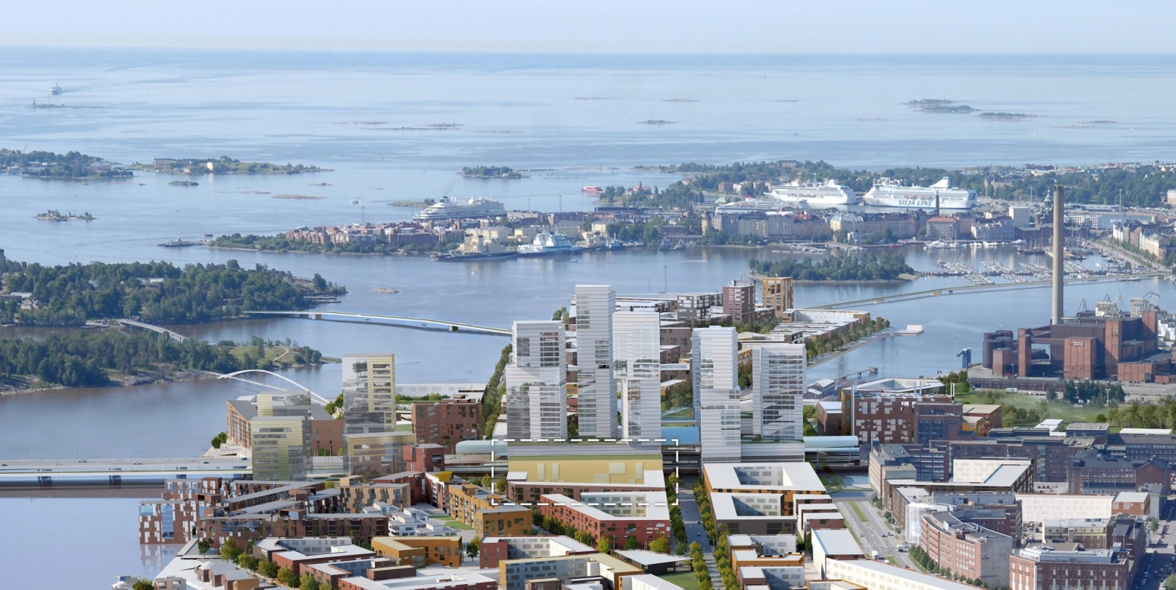
The service network is developed
  Services in 2030

Slide 24
The service network is developed
Why is the reform needed?
Customers' and patients' needs and expectations have changed.
The tightening economy in connection with the population’s changing age structure requires more efficient services.
The City Council has set a goal for integrating the social and health care services.
  -> requires changing the service structure and developing the contents of the services
The reform has already begun
Helsinki's social services and health care were merged into one administrative unit in 2013.
A national social services and health care solution is currently being prepared.
Next phase is integrating the services in accordance with the customer needs.

Slide 25
When services are renewed, operating methods and processes change
Service network
Service
concepts
Service renewal
The development work requires a new kind of management and operating culture, experimentative spirit, and comprehensive recognition of client requirements!

Slide 26
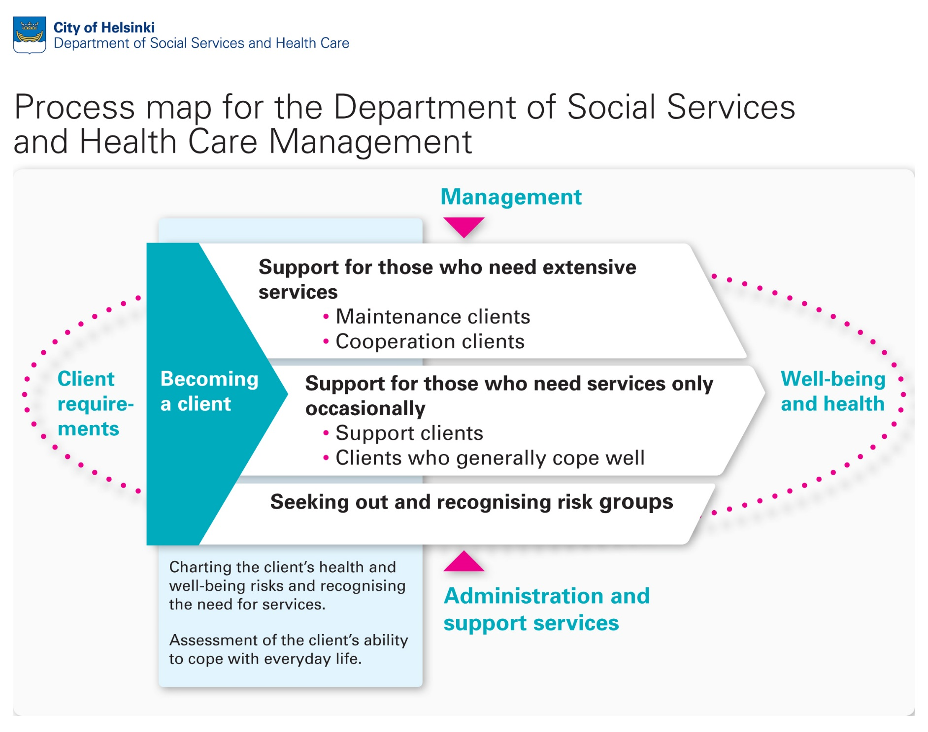

Slide 27
The service network is developed
Health and well-being centres
Reception services of a health station, complemented with mental health and substance abuse services as well as with social services
Will be tested in 2018 in Kalasatama
Services include
Outpatient health care appointment services provided by doctors and public health nurses
Psychiatric and substance abuse services
Rehabilitation services for adults
Oral health care services
Care management for the elderly
Youth and adult social work and social guidance services
Support services (for example laboratory services)

Slide 28
The service network is developed
Family centres
Help for the whole family from a single location
The premise is to improve the chances of preventing problems
Services include
Maternity and child health clinic services provided by public health nurses and doctors
Oral health care services
Home services for families with children
Family work for families with children
Maternity and child health clinic psychologist services
Upbringing and family guidance services
Therapy services (speech, physical and occupational therapy services)
Child welfare initial assessment, non-institutional social work and family work services
Treatment of children's long-term illnesses and rehabilitation services

Slide 29
Child Health Clinic at daycare model
Families are offered the chance to conduct their 3-year-old's health examination, oral health examination and early childhood education discussion at the same time at their day care centre
Developed based on a trial conducted at 5 day care centres in the southern area
Feedback has been good, achieving a school grade of 9- from customers and 9 from personnel (28 October 2015)
A decision on the establishment and expansion of the model will be made for 2016 based on feedback received from the trial

Slide 30
Electronic family coaching/
Family support page
Online family coaching for families expecting their first child
Includes expert articles, videos and care instructions
Combines materials produced by the City, HUS and associations
Created collaboratively by the Department of Social Services and Health Care and the Department of Early Education and Care
www.hel.fi/www/perhevalmennus/en
In the next phase the website will be expanded to cover families with toddler-aged children / Family support page
  the aim is to provide families living in Helsinki with multichannel electronic services

Slide 31
Electronic family coaching/
Family support page
Online family coaching for families expecting their first child
Includes expert articles, videos and care instructions
Combines materials produced by the City, HUS and associations
Created collaboratively by the Department of Social Services and Health Care and the Department of Early Education and Care
In the next phase the website will be expanded to cover families with toddler-aged children / Family support page
  the aim is to provide families living in Helsinki with multichannel electronic services

Slide 32
Monipuolinen palvelukeskus
Ikääntyneiden palvelut kotona asumisen tueksi
Moniammatillinen
osaaminen
Eri palveluja
eri tarpeisiin
Tuki tuodaan
asiakkaan luokse
Sähköiset
palvelut 24/7

Slide 33
The service network is developed
Comprehensive Service Centres
Support for living at home
Different housing options for the elderly
Services include
Service centre activities and day activities
Social and local work for the elderly
Informal care activity centre
Home care
Assessment and rehabilitation activities
Short-term part time and around-the-clock care
Long-term around-the-clock assisted sheltered housing or institutional care
In addition to these, health and substance abuse services and activities organised by volunteers, for example
Some services will also be offered to under-65-year-olds

Slide 34
Examples of new innovations for older people
  Home care remote care visits (costs less than a fifth of a traditional visit)
  Remote rehabilitation
  Home care remote registration and steering

Slide 35



Thank you for your interest!
www.hel.fi/en

