Slide 1
Contracting Today

Slide 2
The purpose of contracts
Digital technologies are transforming markets, supply chains and operational interdependencies
Society is demanding increased supplier responsibility and integrity
Success depends on new partnerships, increased collaboration
A consequence is the need for increased clarity of commitments and obligations

Slide 3
“Contracts today are a framework for business operations”

Slide 4
Driving Change.
Relational Contracting exists in a spectrum of collaborative models

Slide 5
High-Performance Contracting
How does a contract enable value? Through terms that:
Set mutual objectives
Establish performance management systems
Champion problem solving
Instill a “no blame” culture
Foster joint working
Enhance communication
Promote continuous improvement
Define gain sharing arrangements

Slide 6
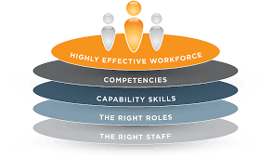
Supporting the business with new commercial models
Outcome / performance based contracts
Payment by results
Relational contracting
Agile contracts
Shared benefit contracts

Slide 7
Benefits realized when using PBCs
Typically, performance-based contracts allow us to…
31.7
strongly disagree
strongly agree

Slide 8
Challenges related to using PBCs
Typically, performance-based contracts come with the challenge of…
31.7
strongly disagree
strongly
agree

Slide 9
Contracting competence
The winners will be those who:
Deliver outcomes
Enable the effectiveness of others
Challenge traditional attitudes and behaviours

