Slide 1
15.-16.6.2016
ADVISORY BOARD SEMINAR

Slide 2
MORFEUS is
a joint cross-disciplinary research project of
Aalto University (SimLab) and Laurea University of Applied Sciences
(01/01/2015–30/6/2017).
The partners of the research project comprehensively represent
wellbeing service actors in Uusimaa
from the municipality sector, the producers of wellbeing services
and the producers of digital tools and consulting services.
www.morfeus.fi

Slide 3
RESEARCH TEAMS
Aalto University
Soile Pohjonen, LL.D., Principal researcher
Marika Noso, M.Sc. (Econ.)
Anna Salmi, MA
Joel Kinnunen, B.Sc. (Tech.)
Accountable director: Riitta Smeds, professor
Laurea University of Applied Sciences
Päivi Pöyry-Lassila, PhD, Project manager
Tarja Kantola, PhD (Educ.), Project manager 16.7. – 16.11.
Tarja Meristö, D.Sc.(Econ.)
Elina Rajalahti, PhD
Hanna Tuohimaa, M.Pol.Sc.
Sini Granström, BBA
Lauri Majuri, BBA
Roni Nukarinen, student
Accountable director: Isto Mattila, director

Slide 4
The research environment: The ecosystem of wellbeing services
The actors and their relations
The structures and processes

Slide 5
The research object: Facilitation of multi-professional collaboration in the ecosystem
Co-creation of customer-centered services
Information and knowledge sharing
(special challenge: siloes)

Slide 6
MORFEUS had three main starting points
Service Information Modeling (SIM)
Social and health care reform in Finland (Sote-uudistus)
Digitization

Slide 7
MORFEUS: An imaginary family case as a viewpoint
Multiple problems
Mental health
Substance abuse
Child protection
Pupil service

Slide 8
We started by mapping in workshops 2015
the common understanding of the expectations and
the actors and their relations from the perspective of the family case

Slide 9
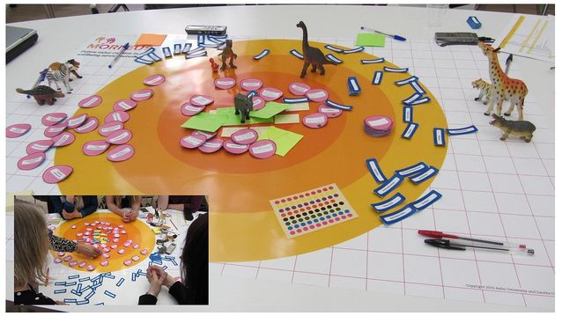

Slide 10
Workshop results: Self-directed, comprehensive multitask job descriptions are desired
Case managers
One-stop shops
Self-direction requires good support structures and tools

Slide 11
Case manager
Crosses siloes
Holistic help

Slide 12
SIM (Service Information Modeling)
Information modeling of services
From modeling to metamodeling
Modeling realized in views

Slide 13
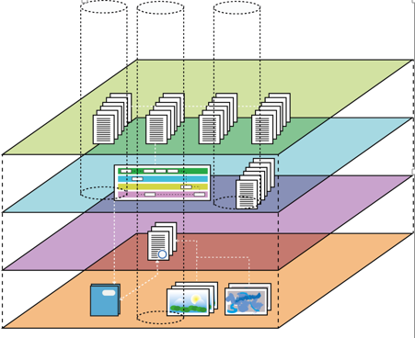
SIM METAMODELING
USER VIEWS
CLIENT- NEEDS, DEMAND
SERVICE SUPPLY
SERVICE PLATFORM SOTESTORE
SERVICE PROVIDERS - STRUCTURES
§
PROVIDERS OF OBLIGATIONS AND RIGHTS

Slide 14
Service platforms (Sotestore)
Developing ecosystems (counties?) - internet communities with community managers
Taking freedom of choice seriously
Access to databanks
Co-creation of services
Experiments, experiences
Contracting, public procurement
Buying services – buying contracts
§

Slide 15
For example:
Patient data
Therapy service provider
My appointments
Work processes
My service providers
Application deadlines
My service process
My rights
Digital tool: customer interface
(prototype)
Digital tool: interface of the professional
(prototype)
Communication

Slide 16
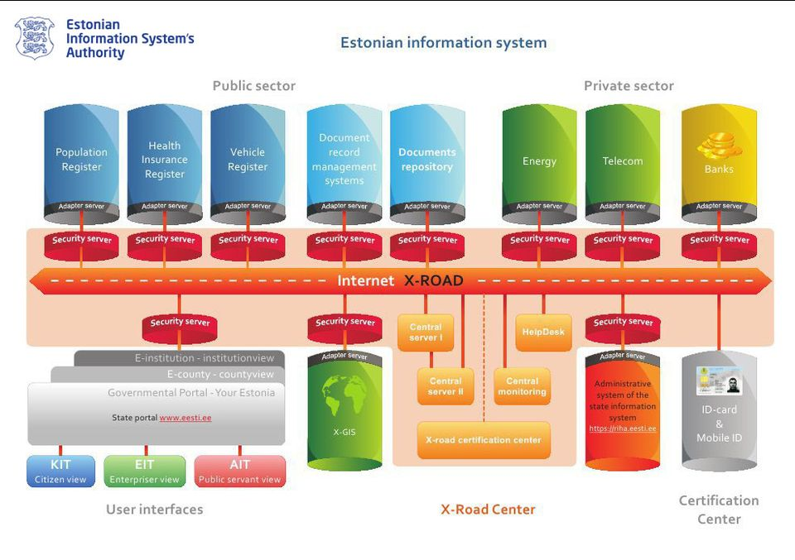

Slide 17
Cases

Slide 18
Case ”HUS”
the Hospital District of Helsinki and Uusimaa
Notes:
Goal setting session
- the administrative chief physican and the chief of the department of psychiatry

Slide 19
Goal of the case
Research question: How to prevent young men from social marginalization?
Notes:
Social marginalization
-nation wide problem, especially among young men
Need for proactive and preventive services
psychiatric patients in some point in life
humane as well as from economical point of view
prevent the youth from marginalization

Slide 20
Research questions
Root causes of the marginalization and the needs of the young men
Interviews of the experts (19 interviewees, 8 organizations)
How the world of the youth looks from the perspective of the professionals?
What are the causes of the social marginalization?
Service Probe (4 young men, 1 week whatsapp-messages, 1 interview)
How the world of the young men looks from their own perspective?
Service ideas
Workshop (for 5 authorities)
Online service design –experiment
How the service ideas can be developped further in online environment?
Existing processes of student welfare services and adolescent psychiatry outpatient treatment
Process modeling: (8 interviews of the professionals)
How the processes enable and disable multi-professional information sharing and cooperation?
Notes:
Fall 2015 – spring 2016
The aim was to get information about the everyday life from the young mens´perspective: what aspects the young men value most in their lives at the moment, what kind of future dreams they have, how they cope with difficult situations/things in their lives, who are the most important people they rely on and where do they see themselves standing in relation to service providers (subject/object).

Slide 21
Research methods
Root causes of the marginalization and the needs of the young men
Interviews of the experts (19 interviewees, 8 organizations)
How the world of the youth looks from the perspective of the professionals?
What are the causes of the social marginalization?
Service Probe (4 young men, 1 week whatsapp-messages, 1 interview)
How the world of the young men looks from their own perspective?
Service ideas
Workshop (for 5 authorities)
Online service design –experiment
How the service ideas can be developped further in online environment?
Existing processes of student welfare services and adolescent psychiatry outpatient treatment
Process modeling: (8 interviews of the professionals)
How the processes enable and disable multi-professional information sharing and cooperation?
Notes:
Fall 2015 – spring 2016
The aim was to get information about the everyday life from the young mens´perspective: what aspects the young men value most in their lives at the moment, what kind of future dreams they have, how they cope with difficult situations/things in their lives, who are the most important people they rely on and where do they see themselves standing in relation to service providers (subject/object).

Slide 22
Research methods
Root causes of the marginalization and the needs of the young men
Interviews of the experts (19 interviewees, 8 organizations)
How the world of the youth looks from the perspective of the professionals?
What are the causes of the social marginalization?
Service Probe (4 young men, 1 week whatsapp-messages, 1 interview)
How the world of the young men looks from their own perspective?
Service ideas
Workshop (for 5 authorities)
Service design –experiment
We used digital tools to develop the service ideas further
Existing processes of student welfare services and adolescent psychiatry outpatient treatment
Process modeling: (8 interviews of the professionals)
How the processes enable and disable multi-professional information sharing and cooperation?
Notes:
Fall 2015 – spring 2016
The aim was to get information about the everyday life from the young mens´perspective: what aspects the young men value most in their lives at the moment, what kind of future dreams they have, how they cope with difficult situations/things in their lives, who are the most important people they rely on and where do they see themselves standing in relation to service providers (subject/object).

Slide 23
Research methods
Root causes of the marginalization and the needs of the young men
Interviews of the experts (19 interviewees, 8 organizations)
How the world of the youth looks from the perspective of the professionals?
What are the causes of the social marginalization?
Service Probe (4 young men, 1 week whatsapp-messages, 1 interview)
How the world of the young men looks from their own perspective?
Service ideas
Workshop (for 5 authorities)
Service design –experiment
We used digital tools to develop the service ideas further
Existing processes of student welfare services and adolescent psychiatry outpatient treatment
Process modeling: (8 interviews of the professionals)
How the processes enable and disable multi-professional information sharing and cooperation?
Notes:
Fall 2015 – spring 2016
The aim was to get information about the everyday life from the young mens´perspective: what aspects the young men value most in their lives at the moment, what kind of future dreams they have, how they cope with difficult situations/things in their lives, who are the most important people they rely on and where do they see themselves standing in relation to service providers (subject/object).

Slide 24
Major findings
Needs:
supporting the development of self-reflective abilities of the youth
Help with life management
Meaningful doing (hobbies, studies, friends)
Asset-based view (instead of problem-based)
Challenges in existing processes:
Information between professionals
Difficult to achieve a holistic view of the process
Young clients, their families, professionals in the process
What happens next, what then…

Slide 25
Solution ideas
Needs:
supporting the development of self-reflective abilities of the youth
Help with life management
Meaningful doing (hobbies, studies, friends)
Asset-based view (instead of problem-based)
Challenges in existing processes:
Information between professionals
Difficult to achieve a holistic view of the process
Young clients, their families, professionals in the process
What happens next, what then…
Digital tool: customer interface
(prototype)
Digital tool: interface of the professional
(prototype)

Slide 26
Digital tool: customer interface
(prototype)
Digital tool: interface of the professional
(prototype)

Slide 27
For example:
Patient data
Therapy service provider
My appointments
Work processes
My service providers
Application deadlines
My service process
My rights
Digital tool: customer interface
(prototype)
Digital tool: interface of the professional
(prototype)
Communication

Slide 28
Case Porvoo
Context of the case:
Child protection ecosystem past, present, future
in Porvoo City
15th June 2016
Dr. Tarja Kantola, Dr. Tarja Meristö
Laurea University of Applied Sciences
Tarja Kantola & Tarja Meristö 15th June 2016
Notes:
Goal setting session
- the administrative chief physican and the chief of the department of psychiatry

Slide 29
Objectives of the Case
Formulation of the Ecosystem for Alternative Futures and
Information modelling
in the ecosystem of child protection
in Porvoo City
To find out
the strengths and bottlenecks
in the flow of information
Well-being of family!
Tarja Kantola & Tarja Meristö 15th June 2016
Notes:
Goal setting session
- the administrative chief physican and the chief of the department of psychiatry

Slide 30
Actors in Case Porvoo
Local actors from child protection ecosystem in Porvoo City
Child Protection, Experience Expert, Mental Health and Substance Abuse Services,
Specialized Health Care (HUS Porvoo), School, Nursery School,
Competence Center for Social and Welfare in Uusimaa Region
Laurea UAS, MORFEUS team
Tarja Meristö, Tarja Kantola, Hanna Tuohimaa, Sini Granström
Students related to learning projects (8) and thesis work (4)
Tarja Kantola & Tarja Meristö 15th June 2016
Notes:
Goal setting session
- the administrative chief physican and the chief of the department of psychiatry

Slide 31
Methodological Framework
Action Scenario Approach (ASA)
-future-oriented framework focusing on possible, desirable, avoidable and or probable future alternatives in long run
-from scenario alternatives to active action alternatives based on SWOT analysis and strategic steps (offensive or defensive) towards the vision
-background in futures research paradigm, ASA developed by Tarja Meristö
in her doctoral thesis
Tarja Kantola & Tarja Meristö 15th June 2016
Notes:
Goal setting session
- the administrative chief physican and the chief of the department of psychiatry

Slide 32
Action Scenario Approach – The process and the stages of the Porvoo Case
PESTE
Issue
Scenarios
What are the possible worlds?
Action Scenarios
2. Workshop 6 Oct. 2015
SWOT
Vision
Flexibility
Where can we go and how?
Where do we decide to go?
Strategy
1. Workshop 8 Sep. 2015
3. Workshop 24 Nov. 2015
(Kick-off
11 May 2015)
- Orientative workshop for the future scenario work model
- Based on the interviews
- Corrected by interviews in spring 2016
Who and where are we?
Toward the information modelling:
- Advisory board meeting 1 1st Dec. 2015
-1st Workshop in Porvoo, 15 April 2016
-2nd Workshop in Porvoo, 13 May 2016
Operational plan
Navigation marks
Basic beliefs
Taboos Core competences
MISSION-SCENARIOS
© Tarja Meristö 1991

Slide 33
Map of Actors in the Child Protection Ecosystem (A)
Psykiatrinen päivystys
Nuotta
Psykiatrian osasto
Maalivahti
Mahdollistaja
Maalivahti
Nuoriso-toimi
Voima-piiri
Vertainen
Mielen-terveyden keskusliitto
Terveys-keskus
”Peesaaja”
Kanssakulkija
Voi-kukkia
Koti-palvelu
Ystävät
Typpi
Sivuosa
HUS erikois-lääkäri
Myötäilijä
Isovan-hemmat
Välittäjä
Sukulai-set
Kapteeni
Sankari
A-klinikka
Koulu-tervey-den-huolto
Välittäjä
Pääosa
Tukipilari
Terveys-lauta-kunta
Lasten-neuvola
Altavastaaja
Koulu
-opettaja
-rehtori
-oppilas-huolto
Valistaja
Psykiatri-nen polikli-nikka
Pelasta-kaa lapset
Leipä-jono
Päivä-koti
Sisäänheittäjä
Joukkuepelaaja
Kanssakulkija
Kanssakulkija
Ohjaaja
STM
Aluehal-linto-virasto
Perhe-neuvola
Kirstunvartija
Päättäjä
Oman tien kulkija
Sosiaali-palvelu-toimisto
TE-toimisto
Takinkääntäjä
Poliisi
Ohjaaja
Päättäjä
Pelinrakentaja
Erotuomari
Haastaja
Sosiaali-lauta-kunta
Perämies
MLL
THL
Pelle Peloton
Valistaja
Tarja Kantola & Tarja Meristö 15th June 2016

Slide 34
Research Methods
Data collection:
Interviews (3) & complementary interviews (5)
Web surveys before/between workshops (4)
Data analysis and synthesis:
Participatory action scenario workshops (6)
Tarja Kantola & Tarja Meristö 15th June 2016

Slide 35
Four Alternative Future Scenarios for the Child Protection
1. Promotive (proactive, virtual)
2. Primary (proactive, face to face)
3. Secondary (reactive, face to face)
4. Tertiary (reactive, virtual).
SWOT analysis and action alternatives for each scenario were constructed. By using visionary concept design, smart services and tools have been developed for the case family for the living in alternative scenarios, focusing on the scenario 1. Flexibility for the other scenarios will be generated through what if –questions.
Tarja Kantola & Tarja Meristö 15th June 2016
Notes:
Goal setting session
- the administrative chief physican and the chief of the department of psychiatry

Slide 36
Case Porvoo Scenarios for Child Protection for next 20 years to the year 2035
Virtual (physical service will supply)
Scenario 4 Tertiary
-Illness driven care philosophy
-Virtual based communication
Scenario 1 Promotive
-Health driven care
philosophy
-Virtual based
communication
Reactive
strengths and bottlenecks in the flow of information
Proactive
Scenario 3 Secondary
-Illness driven care philosophy
-Personal contacts
-Traditional , present situation
Scenario 2 Primary
-Health driven care
Philosophy
-Active individuals
-Weak signals collection
Face to Face (virtual service will supply)
Tarja Kantola & Tarja Meristö 15th June 2016

Slide 37
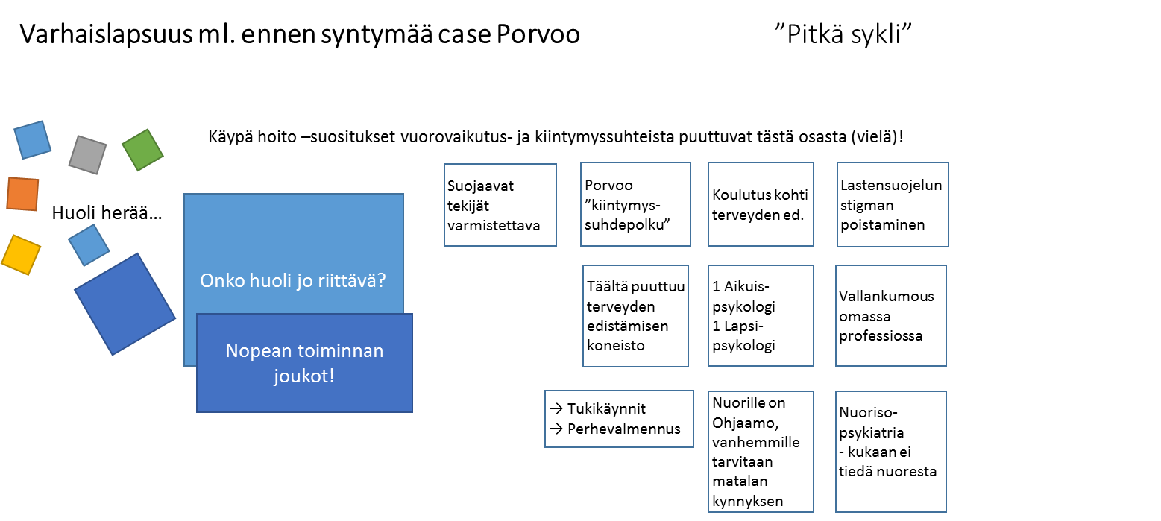
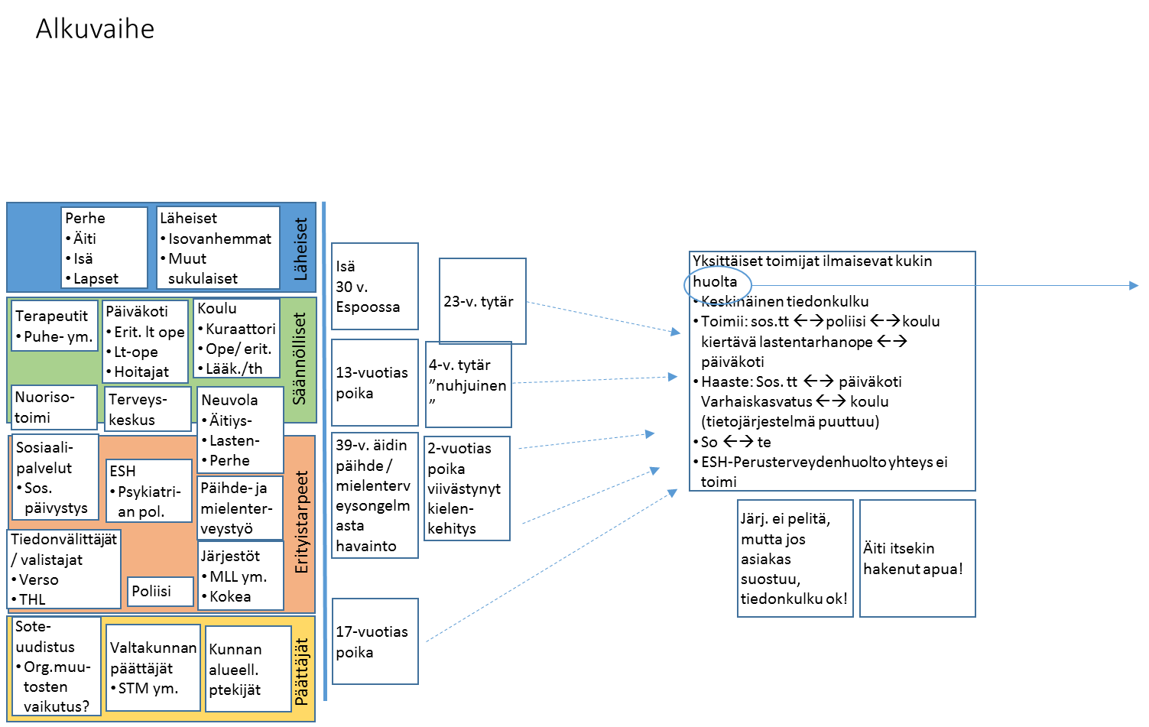
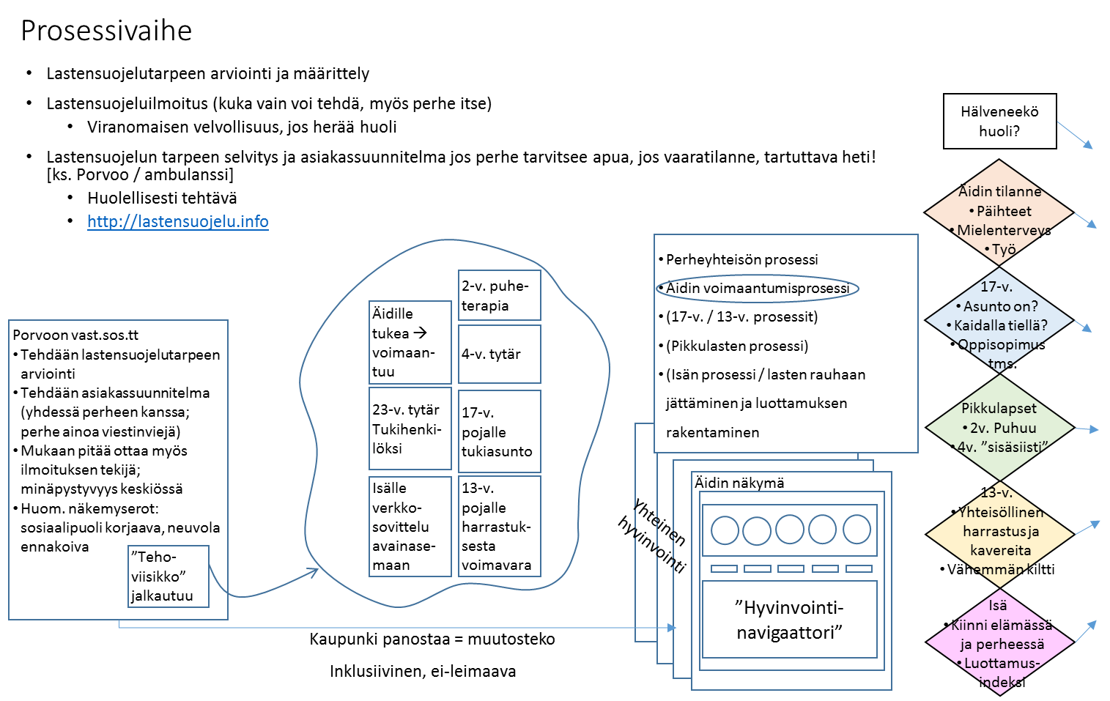
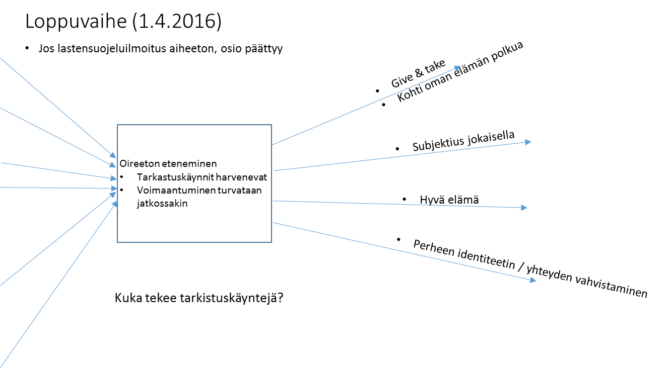
Case Porvoo – The Path of Child Protection just in order to get a glimpse…
I Early Phase (even before the birth) II Starting Phase III Process Phase IV Closing Phase V Follow up Phase
Tarja Kantola & Tarja Meristö 15th June 2016

Slide 38
Mother’s path
Tarja Kantola & Tarja Meristö 15th June 2016

Slide 39
Child’s path
Tarja Kantola & Tarja Meristö 15th June 2016

Slide 40
Early childhood including the time before the birth ”Long cycle”
Suojaavat tekijät varmistettava
Porvoo ”kiintymys-suhdepolku”
Koulutus kohti terveyden ed.
Lastensuojelun stigman poistaminen
Worry arises…
Is the worry enough?
Täältä puuttuu terveyden edistämisen koneisto
1 Aikuis-psykologi
1 Lapsi-psykologi
Vallankumous omassa professiossa
Rapid reaction force!
→ Tukikäynnit
→ Perhevalmennus
Nuorille on Ohjaamo, vanhemmille tarvitaan matalan kynnyksen
Nuoriso-psykiatria - kukaan ei tiedä nuoresta
Tarja Kantola & Tarja Meristö 15th June 2016

Slide 41
Initiating state
Proactive, worry will arise here and there
Well-being of child families, without the customer relationship with child protection
Early intervention
Single actors express a worry separately
Information flow:
Works well: sosial and healthcare ←→police ←→school circulating nursery teacher ←→ nursery school
Challenge: social and health care ←→ nursery school ←→ school (missing a shared information system)
Social ←→ health care
Not functioning: specialized care – primary health care
Perhe
Äiti
Isä
Lapset
Läheiset
Isovanhemmat
Muut sukulaiset
Läheiset
Isä
30 v.
Espoossa
23-v. tytär
Terapeutit
Puhe- ym.
Päiväkoti
Erit. lt ope
Lt-ope
Hoitajat
Koulu
Kuraattori
Ope/ erit.
Lääk./th
Säännölliset
13-vuotias poika
4-v. tytär ”nuhjuinen”
Nuoriso-toimi
Terveys-keskus
Neuvola
Äitiys-
Lasten-
Perhe
Sosiaali-palvelut
Sos. päivystys
39-v. äidin päihde / mielenterveysongelmasta havainto
2-vuotias poika viivästynyt kielen-kehitys
ESH
Psykiatri-an pol.
Päihde- ja mielenter-veystyö
Erityistarpeet
Tiedonvälittäjät / valistajat
Verso
THL
Systems are not functioning well,
BUT
if the customer accepts, information flow works!
The mother
tried to get help herself!
Järjestöt
MLL ym.
Kokea
Poliisi
17-vuotias poika
Sote-uudistus
Org.muu-tosten vaikutus?
Valtakunnan päättäjät
STM ym.
Kunnan alueell. ptekijät
Päättäjät
Tarja Kantola & Tarja Meristö 15th June 2016

Slide 42
Process stage
Lastensuojelutarpeen arviointi ja määrittely
Lastensuojeluilmoitus (kuka vain voi tehdä, myös perhe itse)
Viranomaisen velvollisuus, jos herää huoli
Lastensuojelun tarpeen selvitys ja asiakassuunnitelma jos perhe tarvitsee apua, jos vaaratilanne, tartuttava heti! [ks. Porvoo / ambulanssi]
Huolellisesti tehtävä
http://lastensuojelu.info
Does the worry clear away?
Äidin tilanne
Päihteet
Mielenterveys
Työ
Perheyhteisön prosessi
Empovering the mother!
(17-v. / 13-v. prosessit)
(Pikkulasten prosessi)
(Isän prosessi / lasten rauhaan jättäminen ja luottamuksen rakentaminen
2-v. puhe-terapia
17-v.
Asunto on?
Kaidalla tiellä?
Oppisopimus tms.
Äidille tukea → voimaan-tuu
Porvoon vast.sos.tt
Tehdään lastensuojelutarpeen arviointi
Tehdään asiakassuunnitelma (yhdessä perheen kanssa; perhe ainoa viestinviejä)
Mukaan pitää ottaa myös ilmoituksen tekijä; minäpystyvyys keskiössä
Huom. näkemyserot: sosiaalipuoli korjaava, neuvola ennakoiva
4-v. tytär
23-v. tytär
Tukihenki-löksi
17-v. pojalle tukiasunto
Pikkulapset
2v. Puhuu
4v. ”sisäsiisti”
Isälle verkko-sovittelu avainase-maan
13-v. pojalle harrastuk-sesta voimavara
Own views for family members
13-v.
Yhteisöllinen harrastus ja kavereita
Vähemmän kiltti
Shared well-being
”Teho-viisikko” jalkautuu
”Well-being navigator”
Isä
Kiinni elämässä ja perheessä
Luottamus-indeksi
Kaupunki panostaa = muutosteko
Inklusiivinen, ei-leimaava
Tarja Kantola & Tarja Meristö 15th June 2016

Slide 43
End stage
Jos lastensuojeluilmoitus aiheeton, osio päättyy
Give & take
Towards an own life path
Oireeton eteneminen
Tarkastuskäynnit harvenevat
Empowering in the future as well…
Each family member as a subject
Good life
Strengthening identity and unity of the family
Kuka tekee tarkistuskäyntejä?
Tarja Kantola & Tarja Meristö 15th June 2016

Slide 44
Major Findings
From child protection to proactive wellbeing of child families (vision workshop 5/2015)
Change factors in operating environment come from all PESTE perspectives i.e. political, economic, social, technological, ecological (websurvey 9/2015)
Actors in the ecosystem of child protection consist of core members, supporting members, professional actors in active role in everyday life from different sectors as well as actors as enablers, not in direct contact with case family (workshop 9/2015)
Alternative scenarios will create flexilbility to the information modelling meeting the challenges of the future, too (web-surveys and workshops 10/2015, 11/2015)
Bottlenecks in the ecosystem working with the family will vary from scenario to scenario (web-survey and Board meeting 12/2015)
In citizen–centric ecosystem trust is the key asset, this requires transparency and acceptance without guilty feelings (workshops 4-5/2016)
Worry as a knowledge in child protection ecosystem
Information modelling is key to holistic picture with dynamic user interface to professionals and customers, but in practise the real-life assistant team is needed, too (e.g. effective Team Five)
Tarja Kantola & Tarja Meristö 15th June 2016

Slide 45
Case Porvoo findings related to service information modelling: case family examples
For example: Mother in the case family
Customer data:
Service history during last
years, present situation
My appointments:
Meeting with social worker
Special service provider:
Experience expert group
My service providers:
Mental health clinic et.al.
My service process:
Group meeting with
multi-disciplinary expert group
Customer interface: digital tools in virtual based scenarios, but face to face meetings in the other cases
Interface of the professionals: digital tools in virtual based scenarios, but face to face meetings in the other cases
Communication
Shared vision
Tarja Kantola & Tarja Meristö 15th June 2016

Slide 46
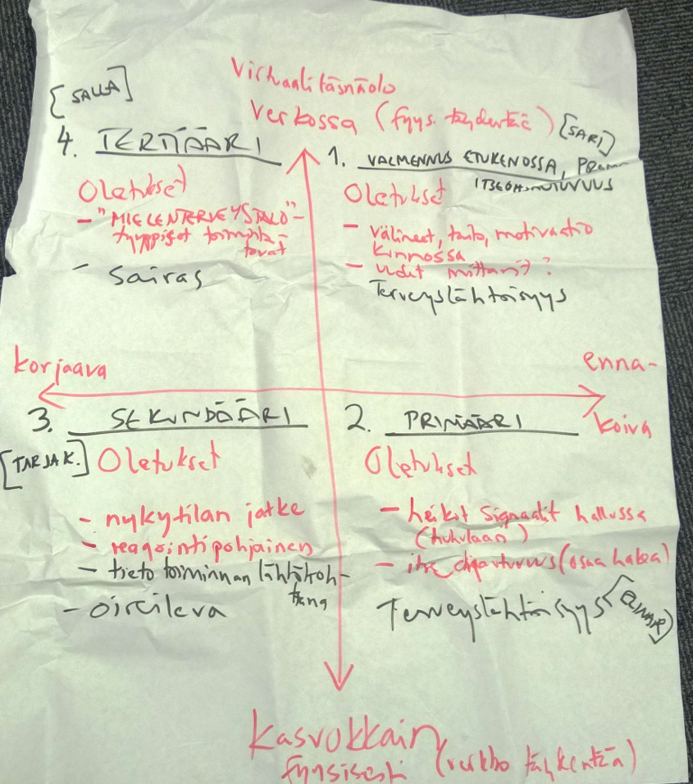
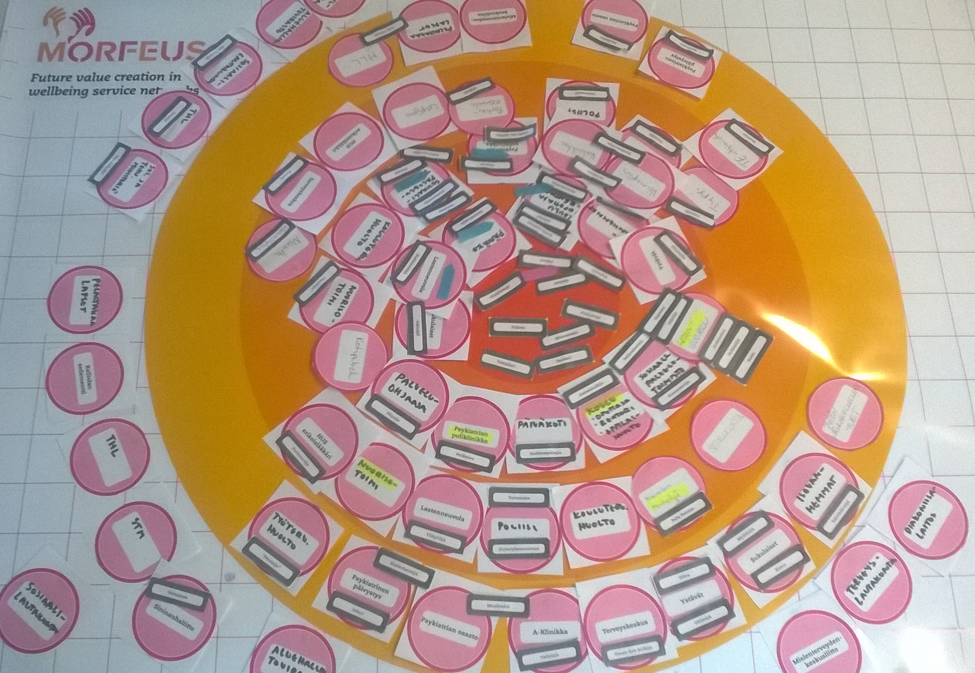
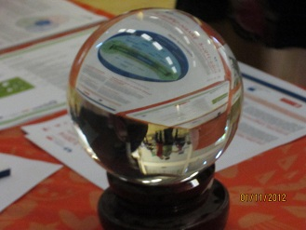
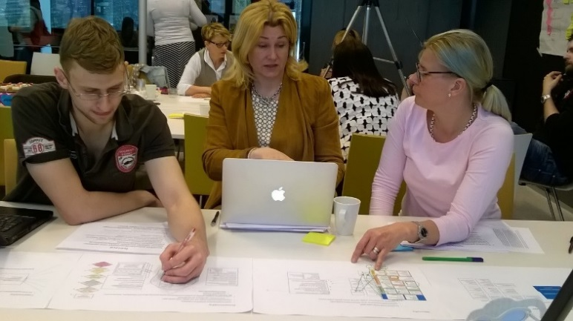
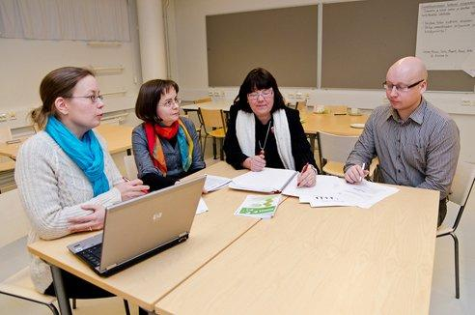
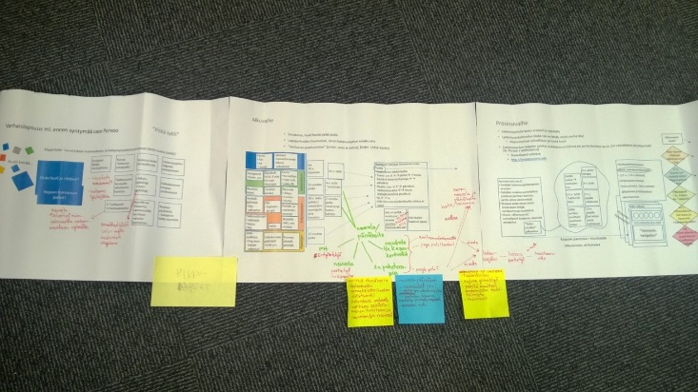
Thank you!
Do not hesitate to contact us concerning case Porvoo!
tarja.kantola@laurea.fi
tarja.meristo@laurea.fi
Find more on futures research in Laurea UAS
FuturesLab CoFi: www.laurea.fi/en/cofi/

Slide 47
Research Results into Practice

Slide 48
Discovered Needs
Need for collaboration and information sharing
between different professionals
between customers and professionals
Need for empowering the customer
more active role in their own well-being

Slide 50
Prototypes for the user views

Slide 51
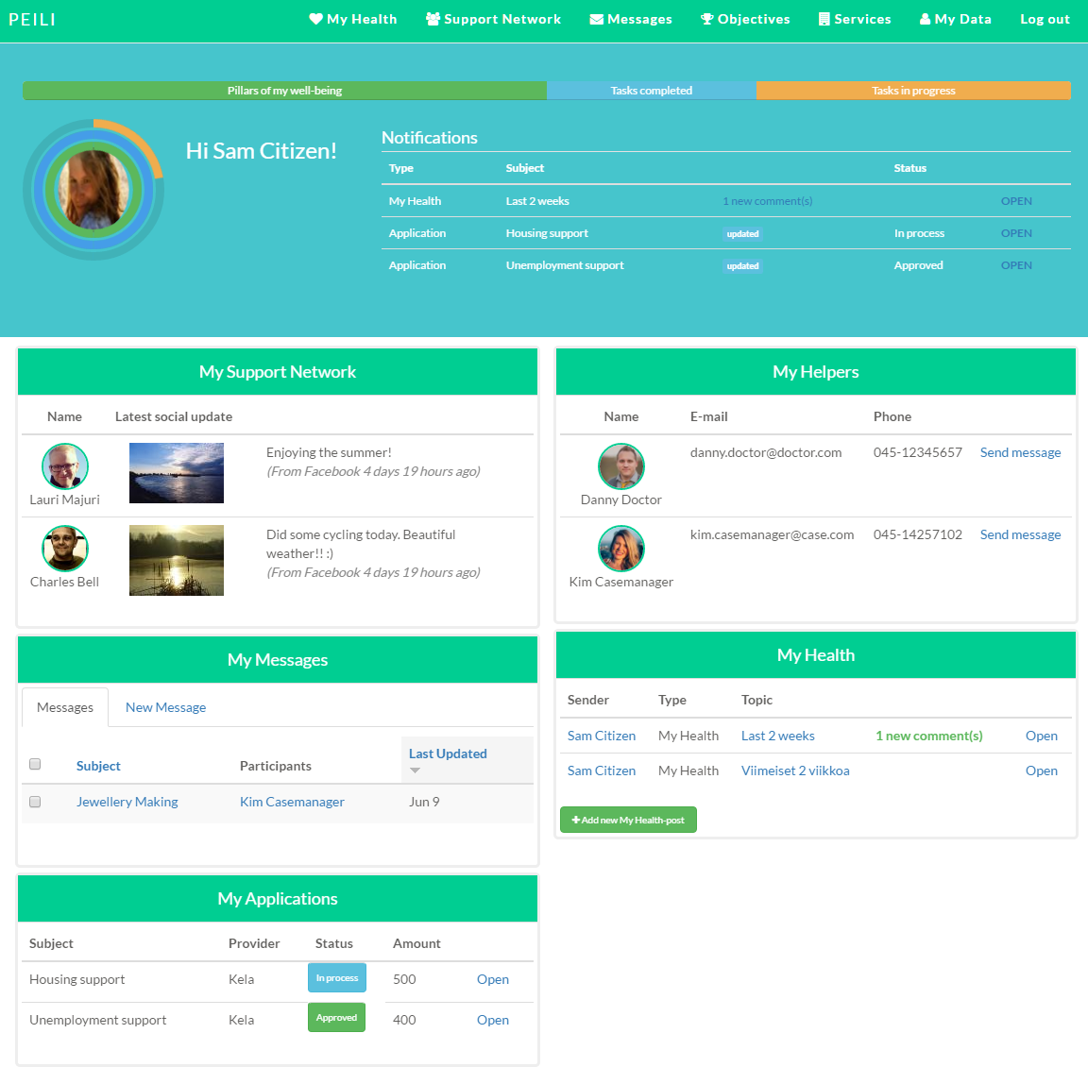
Prototype
Digital well-being platform
Development started in April 2016
User types
Customer/Patient
Professional
Case manager, doctor, social worker, therapist…
Decision maker

Slide 52
”It is a good system, but how can we use it?”

Slide 53
Needs from the field
Digitization – possibility to re-create our ways to work
More real time information
More flexibility

Slide 54
Helps to enter into customer’s situation
Better knowledge to make decisions
Empowering the customer
Transparent process

Slide 55
Implementation
Motivating leadership & decision makers
Employees’ skills (learning to use the platform)
Organizational practices and cultures
Notes:
Culture, organizational factors, org practices

Slide 56
Thank you!

