Slide 1



Slide 2

Patient portal / Personal Health Record Estonian experience since 2007
Peeter Ross, MD, PhD
Tallinn University of Technology, Estonia
East Tallinn Central Hospital
16.06.2016
ADVISORY BOARD SEMINAR OF THE MORFEUS RESEARCH PROJECT
OTANIEMI, ESPOO, FINLAND

Slide 3
Outline
Overview of patient on-line access to own medical data in different countries
Facts about Estonia
Estonian nation-wide Health Information Exchange platform
  Main drivers
  Current situation
Services in Patient Portal
  8 years experience
Difficulties
Future trends

Slide 4
Use of Patient Portals
Country | Consent model | Provider | Name | Signed up for patient access
England | Opt-out | NHS | HealthSpace | 0,01%
France | Opt-in | ASIP Sante | Dossier Médical Personnel (DMP) | 0,5%
Denmark | Opt-out | Danish Healthcare Service | Sundhed.dk | N/A
Estonia | Opt-out | Estonian E-Health Foundation | Patient Portal | 15%
US | Opt-out | Kaiser Permanente Health Plan | My Health Manager | 60%

Slide 5
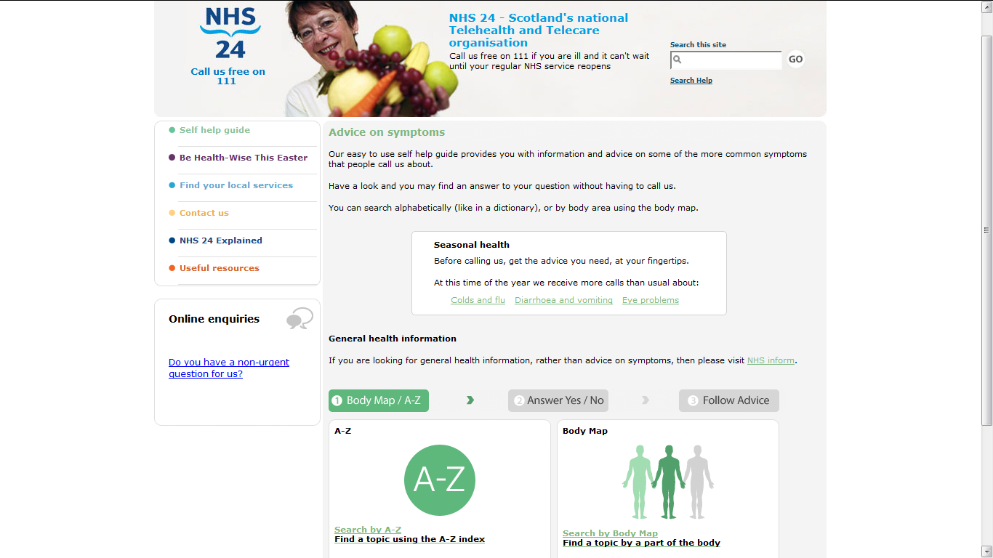
NHS24, Scotland

Slide 6
Estonia.
Facts about e-services
100% of schools and government organisations have broadband connection
Annual reporting 100% on-line
99% financial transactions (bank transfers) carried out electronically
mParking in main cities
88% of households have broadband connection (2015)
96% of income tax declarations are made via the
E-Tax Board (2014)
31% of votes were cast over the internet on (2014)
62% of persons have completed the e-census (2012)
90% fishing permits given out electronically

Slide 7
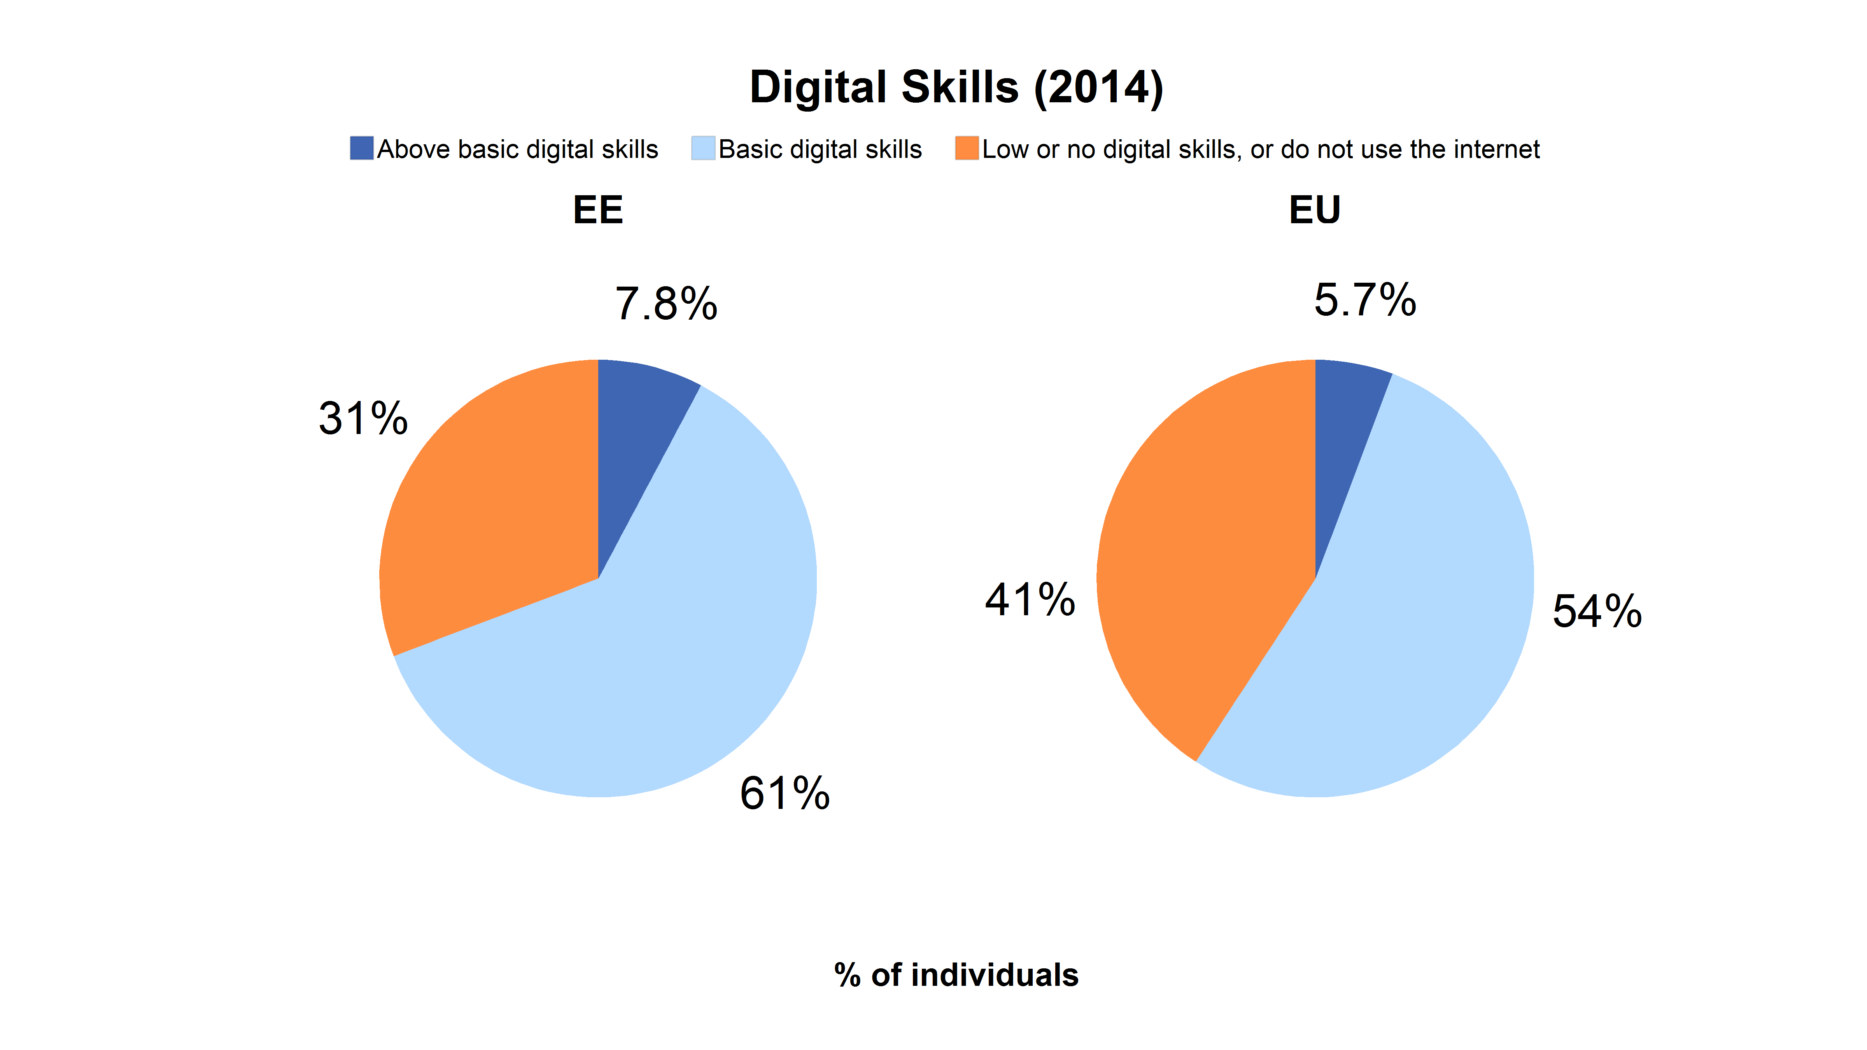
Human Capital: Digital Skills
In Estonia 61% of citizens have basic digital skills (54% in the EU)
and 7.8% have above basic digital skills (5.7% in the EU)
Source: Pilot work carried out by DG CONNECT in relation to action 62 of the Digital Agenda to propose "EU-wide indicators of digital competence". It is proposed for regular implementation starting with the 2015 survey.

Slide 8
Servise oriented development
Reduced number of unused bookings
Replacing doctors visits with nurses visits
More efficient time management
Receive medication on time
Prevent complications
Improved self-management of disease
Fewer hazardous examinations
Shorter visit times
Better overview of personal medical data
Patient can add personal self-monitoring data
Research of personalized healthcare/ medication
Interactive prevention of disease for citizen
Benefits to achieve
Citizen
Healthcare provider
Society
Define user case
Sustainability of healthcare systems
Chronic disease management
Efficiency of patient pathways
Innovation in health – innovative models of care
Challenges of healthcare
Business process development
Basic process
Supportive processes
Roles, stakeholders
Data, materials
Service user
Patient portal
Secure authentication
Process
Shared services
Case stories
Standard contents
Service levels
Owners
Service users
Service providers
Services
Prescription
Care process
Documentation
Billing
Diagnostic
Medical record
Working process
optical network
Staging/Storage
Security gate
15 Years of e-health development
EHR
Servers
Servers
Application integration
  Messages exchanges
  Users rights
  Sharing data
  Coordination of changes
  Monitoring
Fire alarms
Servers
EHR
Servers
Ntwk
Servers
PACS
ProLiant
Network
Coolinsystem
GP-s EMR
Housing of infrastructure
  Shared serveres
  Shared storages
  Networks
  System maintenance
Data storage
Data storage
Coolingsystem
Ntwk
Servers
ProLiant
Integrity
Network
Storage
Storage
Electrical network
Integrity
HIS
Prescription
repository
LAN
& Backup
& Backup
Registry
Servers
Servers
LAN
Electricity , UPS
Gateway
Electricity , UPS
Physical facilies
Ross&Tiik 2011®

Slide 9
Estonian nation-wide Health Information System (EHIS)
The Estonian HIS is unique as it
      Encompasses the whole country
      Registers virtually all residents’ health history from birth to death, and
      Is based on the comprehensive standard based IT infrastructure

Slide 10
HIS platform history
Project preparation (2003-2005)
eHealth Foundation established
eHealth Projects (2006-2008)
Digital stamp
Planning initiated
2000
2003
2006
2008
2010
2015
Funding decision by Ministry of Economic Affairs
National HIS
ePrescription
Implementation of new
e-services
Electronic Health Record
Digital Images
Digital Prescription
Digital Registration

Slide 11
Basic components
The EHIS platform consists of 3 main layers
  The secure internet-based data exchange layer
  Health information exchange database and software
  Application and service layer

Slide 12
Main characteristics
The data exchange layer is a messaging middleware which works as system integration layer
Based on usage of Web Services
Meets high security requirements
Works as a service bus
Provides uniform way for the offering, discovering and using services
Highly scalabe

Slide 13
Estonian eHealth architecture
STATE AGENCY OF MEDICINES
- Coding Centre
- Handlers of medicines
HEALTH CARE BOARD
- Health care providers
- Health professionals
- Dispensing chemists
QUALITY REGISTERS.
Cancer. HIV. Myocardial infarction.
Tuberculosis. Etc.
POPULATION REGISTER
BUSINESS REGISTER
HOSPITALS
2009
FAMILY DOCTORS
2009
PHARMACIS
2010 January
SCHOOL NURSES
2010 September
EMERGENCY MEDICAL SERVICE
2014
Secure data exchange layer provided by the state
X-Road, ID-card, State IS Service Register
NATION-WIDE
HEALTH
INFORMATION
EXCHANGE PLATFORM
2008 December
PRESCRIPTION
CENTRE
2010 January
PATIENT PORTAL
2009
X-ROAD GATEWAY SERVICE
2009
PHARMACIES AND FAMILY DOCTORS
2009

Slide 14
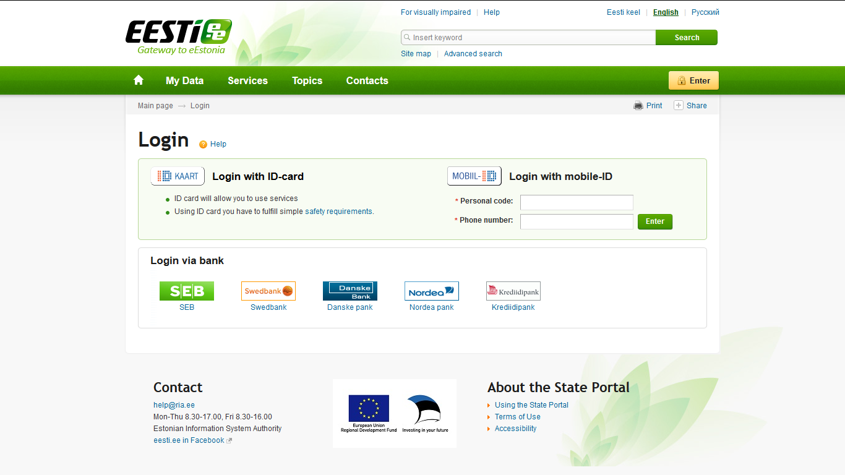
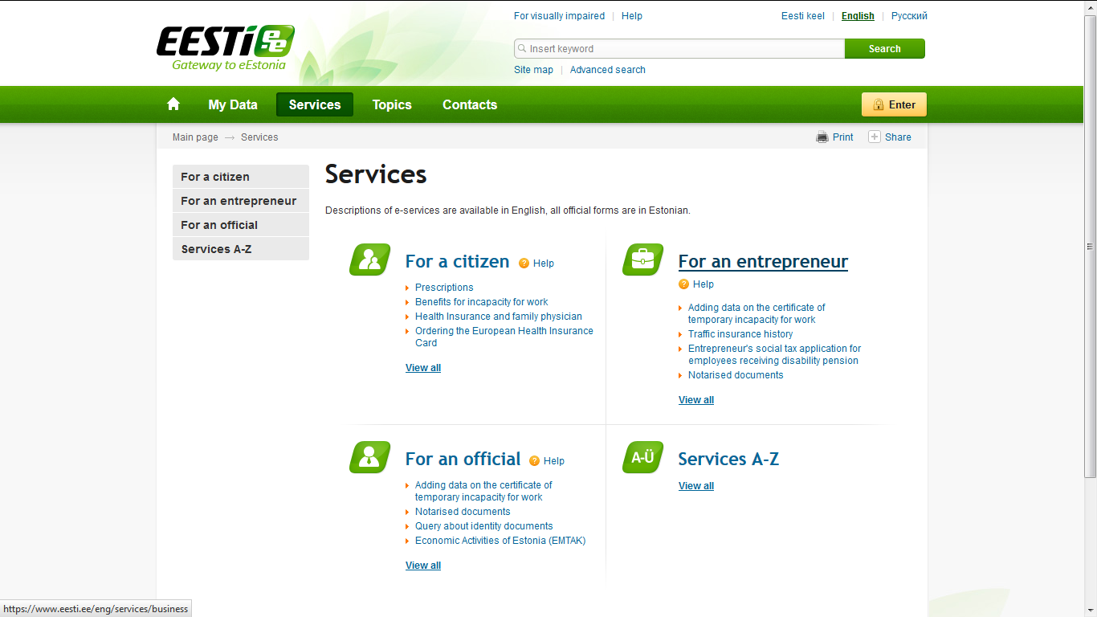
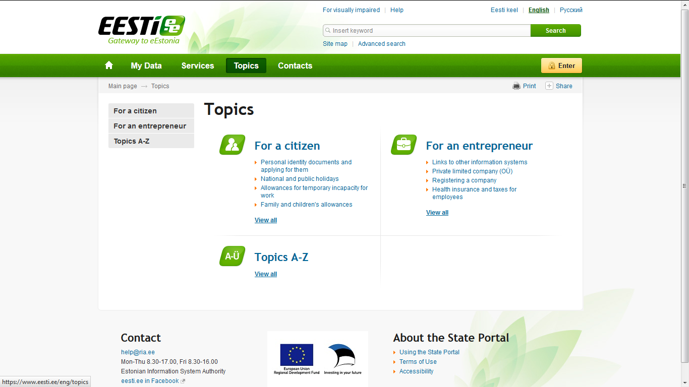

Slide 15
Main drivers
Clear governacne of Estonian e-health services
  Estonian E-Health Foundation
Legal clarity
Mature ecosystem for e-services in Estonia
  Secure data exchange platform provided by the state
  Established on-line identification methods
    ID-card
    Mobile-ID
Agreement about access rights
Standardization
  Medical data
  Data exchange

Slide 16
eHealth services in Estonia
Nation-wide health information system
  Available documents
    Medical files
      Time critical data (allergy, chronic diseases)
      General practitioners and hospital visits
      Summary of ambulatory and stationary case
      Link to medical images
      Referral letter
ePrescription
Digital images
  Available all over the county
eReferral
eAmbulance
Drug-drug interaction service
Cross-sectoral services
  Health declaration for driver licence exchange
  Working incapacity assertion

Slide 17
Legal environment of eHealth
The Health Services Organisation Act regulates the development and maintenance of the health information system
  Lay down the necessary requirements to the patient, health service provider, document standards, etc.
All healthcare providers must send certain health data to national HIS
  The set of documents is defined by the law
Access only to licensed medical professionals
  The attending doctor concept
Patient has the right to close own data (opt out)
The ethical committee was created to lead the discussions of patients´ rights and to select the proper system for the HIE platform
Citizen can
  Access their own data
  Declare intentions and preferences
  Monitor logs

Slide 18
Security and electronic authentication
The access to EHIS is secured by using two level security check:
  Electronic identity card (compulsory ID-card issued by the state)
  Mobile-ID
ID-card is a compulsory and primary document for the purposes of personal identification in Estonia
All attempts to view health care data are monitored both by patients and Estonian eHealth Foundation
In case of the suspicions of the unlawful access to the data the necessary actions are taken immediately

Slide 19
Current situation
23 343 302 million medical documents
  14 different documents
Health information about 1 463 401 million inhabitants (Estonia has 1 320 000 million inhabitants)
Ambulatory case summaries – 12 100 995 million
Exam reports – 5 487 220 million
Stationary case summaries – 1 468 496 million

Slide 20
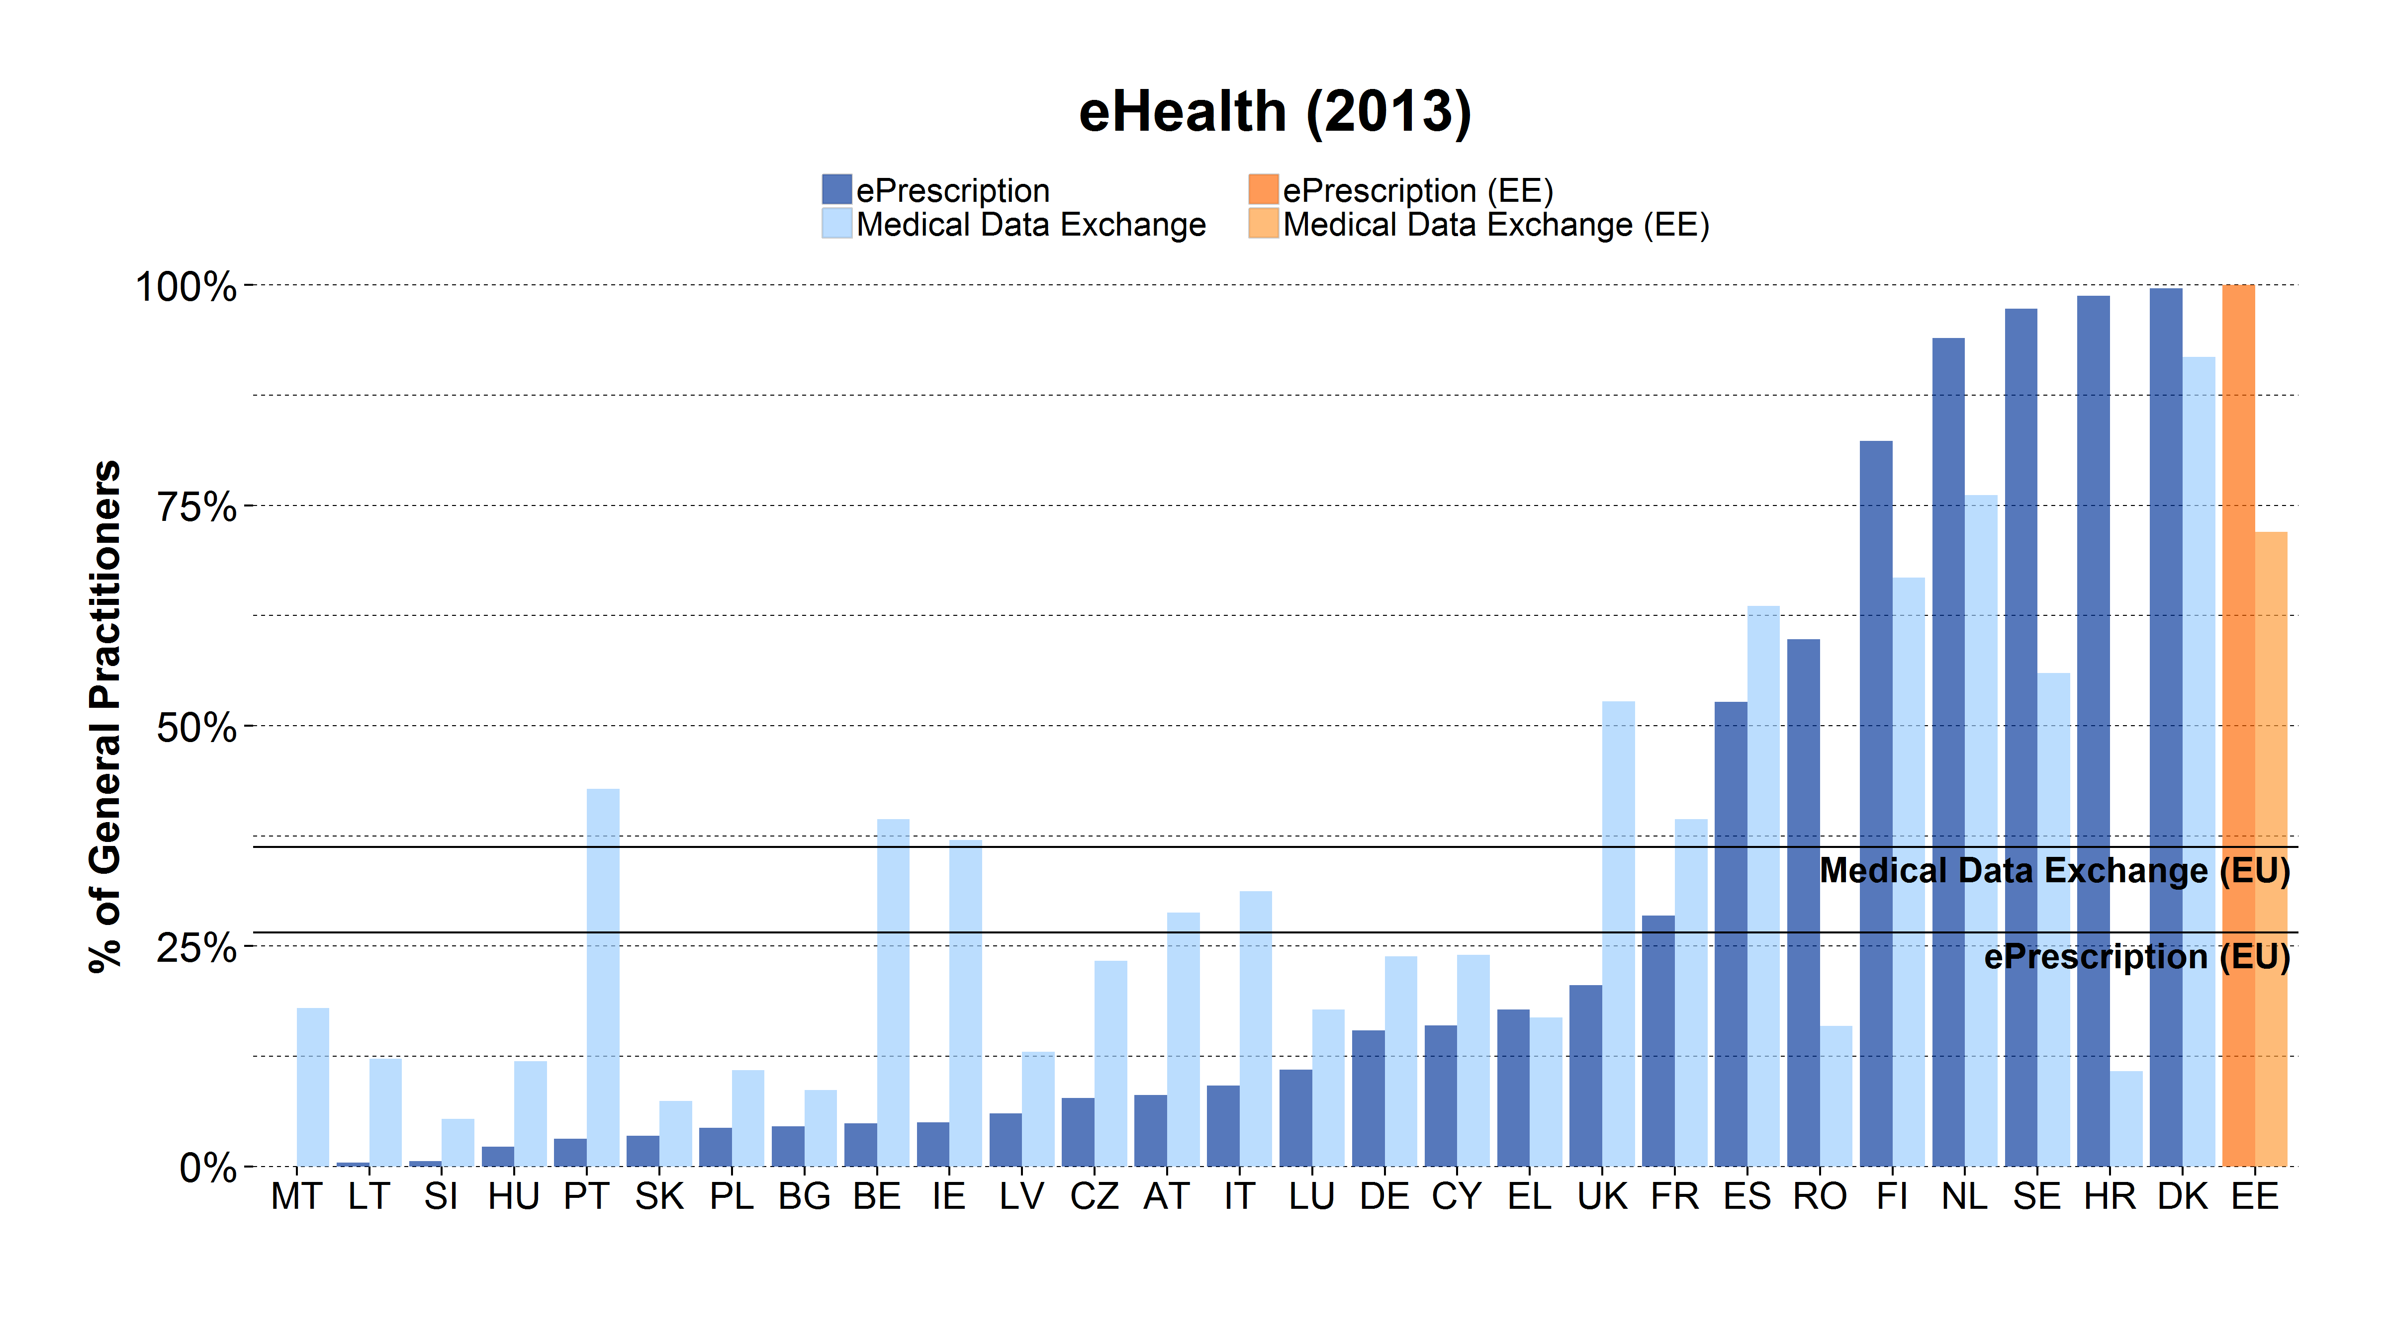
Digital Public Services: eHealth
100% of Estonian General Practitioners send prescriptions electronically to pharmacists (27% in the EU)
and 72% exchange medical information electronically with other healthcare providers (36% in the EU).
Source: Benchmarking Deployment of eHealth among General Practitioners

Slide 21

Patient Portal
Log in with ID-card or Mobile-ID
View and update personal data and add contact data of close relative
View his/her medical data (electronic health records) from health care providers
View electronic referral letters
  View all electronic prescriptions
Add representatives for him-/herself for different actions (e.g. buying out e-prescriptions);
Make declarations of intent (e.g. donation of organs);
Access health insurance data;
Mask sensitive health data for doctors or representatives;
  Fill in a health declaration form before doctors’ appointment
Get the overview from a log file of who has viewed his/her data.

Slide 22
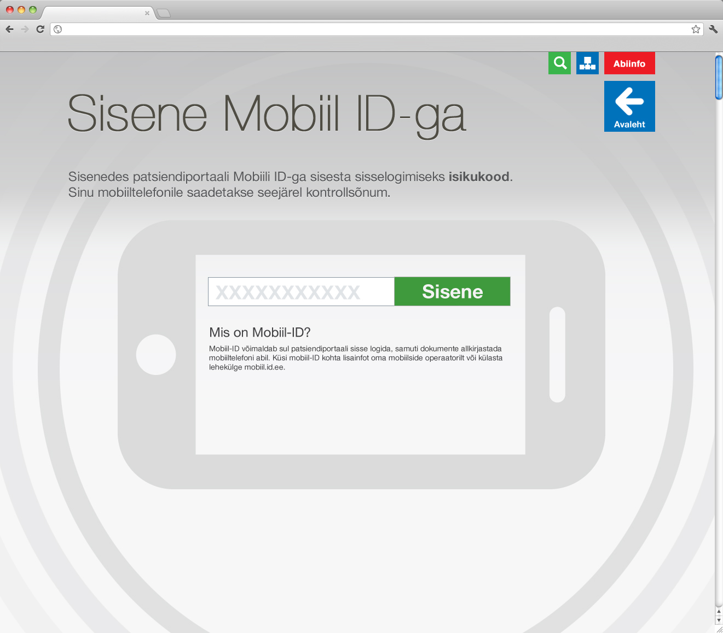

Slide 23
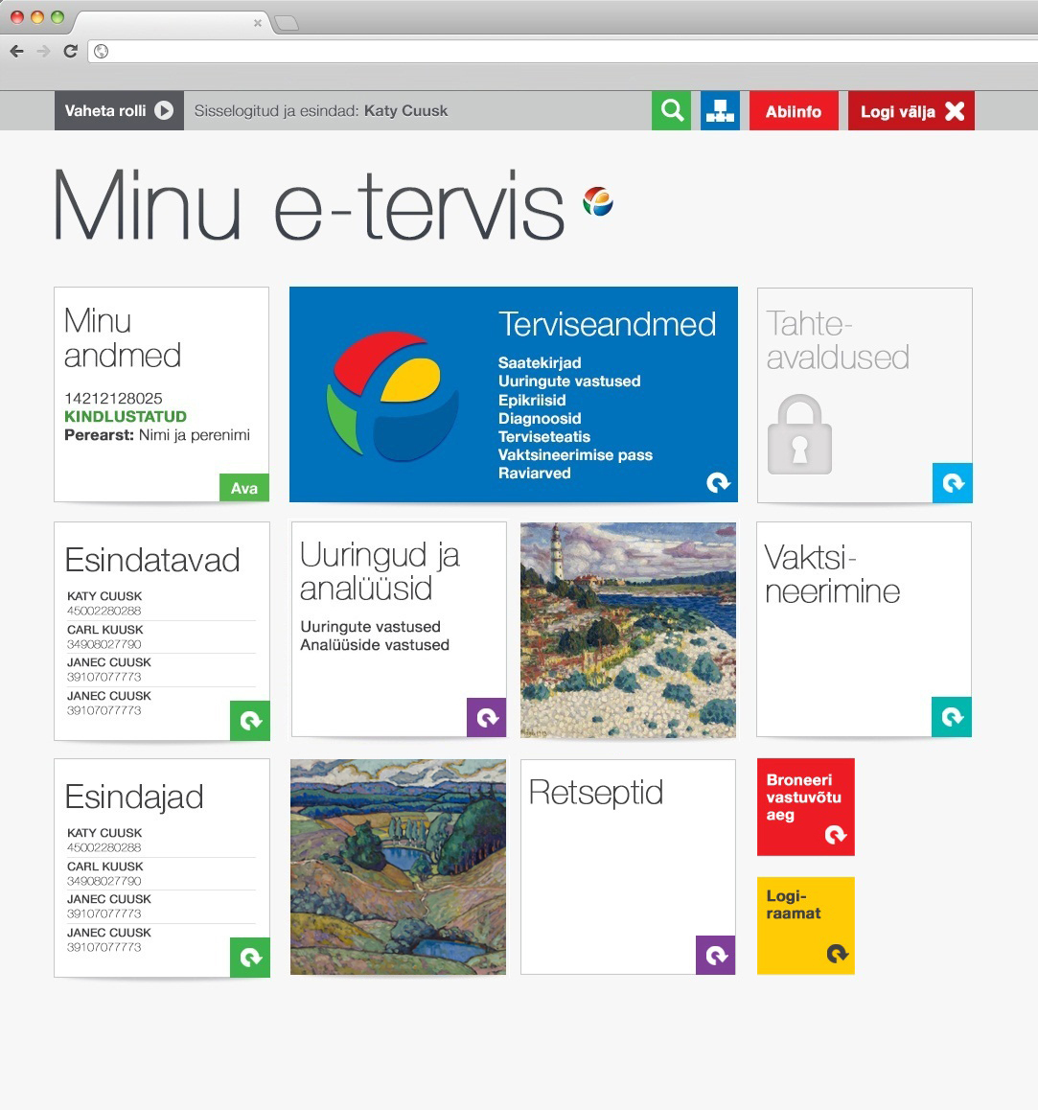

Slide 24
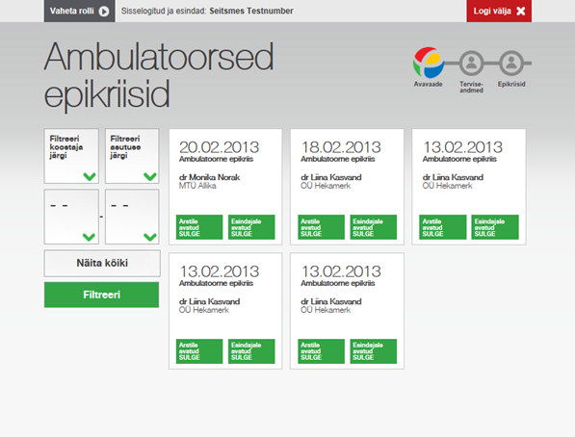
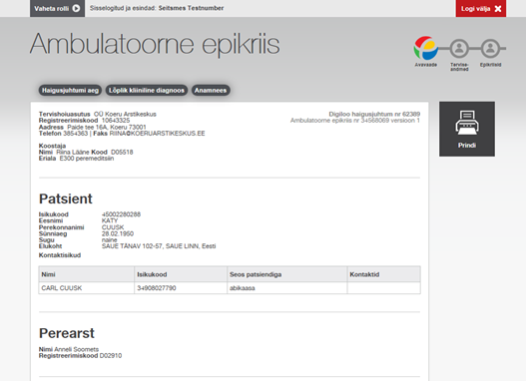

Slide 25
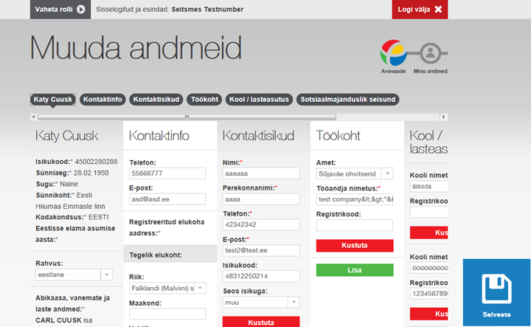

Slide 26
Conclusions
Feedback from the health care providers’ and Estonian E-health Foundations´ helpdesk also shows that when patients do not have access to their health data (for example due to the upgrade of the system), they immediately contact the helpdesk.
They are interested in when the data will be available as they must periodically or before doctors´ appointment view their test results.
This information supports the idea that by making health data easily accessible to the patients, they will take an active role of monitoring ones´ health.

Slide 27
Acceptance
ePrescription covers 98% of issued prescriptions
Close to 100% of Hospital discharge letters are digital
Ambulatory case summaries sending level is high
Patient portal usage is low but increasing
  224 302 unique visitors (15% of population)
  1 463 401 persons have documents (82% of population)

Slide 28
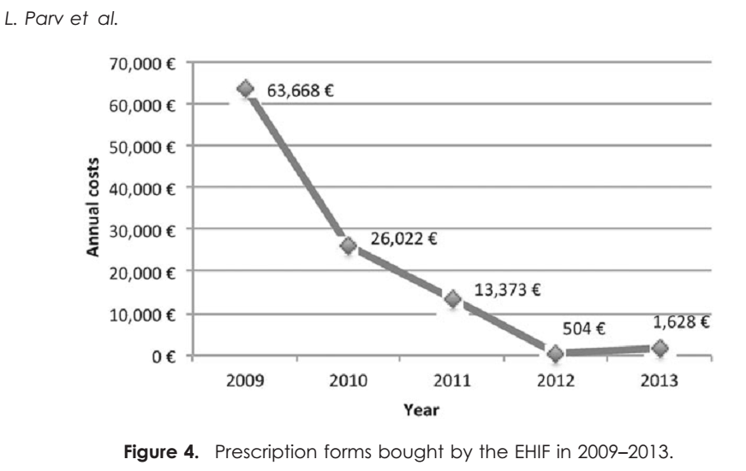
ePrescription, Estonia
98% of prescriptions are issued in electronic form

Slide 29
Use of eHealth platform by healthcare professionals, Estonia

Slide 30
Hospital Patient Portal - iPatient
Services in iPatient
  Up-to-date information (24h from any location);
  Access to all medica data, including medical images.
  Booking, rescheduling and cancelling of the appointments times;
  SMS and e-mail reminders of appointment times;
  Enables patients to share the information in the electronic record with other clinical specialists;

Slide 31
Logins to iPatient
by age and gender in 2012

Slide 32
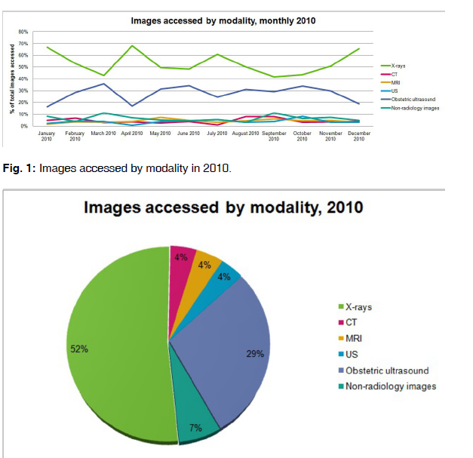
Viewing of radiology images (2010)
During 12 months (Jan-Dec 2010) there were 3750 (11/day) patients accessing their images from outside the hospital.

Slide 33
Observations and difficulties
Physician and other professionals had change the way they fill in the medical files in some extent – the trend is towards more uniform language
General acceptance of hospital personnel to share medical data in patient portal with patient was problematic
Much attention had to be paid on the security and electronic authentication of the users
In some cases users could not log in as their ID-card software or certificates had not been updated
Also some data saving problems during the appointment time booking were observed
Not all internet browsers were supported

Slide 34
Involvement of patient groups
Initial phase of planning of national health information system was done by Ministry of Social Affairs
  Patient involvement was through the ministry
The experience of patient portal usage showed that there is a need for secondary and personalised services
  The new patient portal planning is done with close cooperation with several patient organisations.

Slide 35
Conclusions
Improve the communication between different parties
  To empower patients and motivate doctors to use the collected information and eHealth services
It is important to motivate physicians to tell patients about the possibilities to view and to be aware of their basic health data
It is important to inform patients about these possibilities and to support them actively inform their physicians that they know how to use their health data.

Slide 36
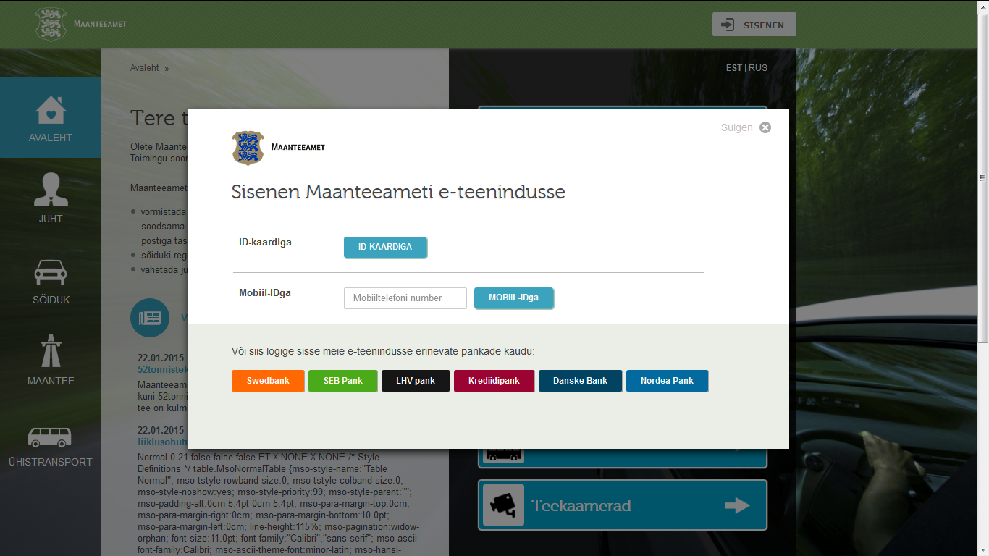
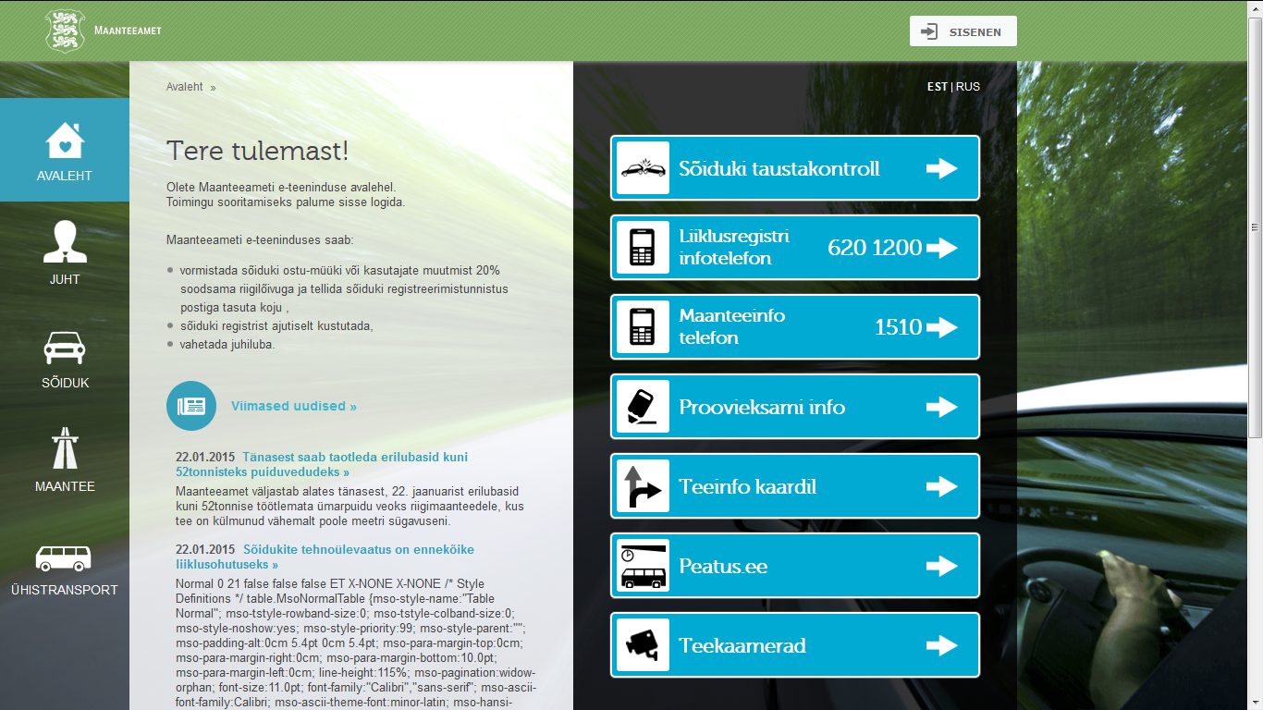
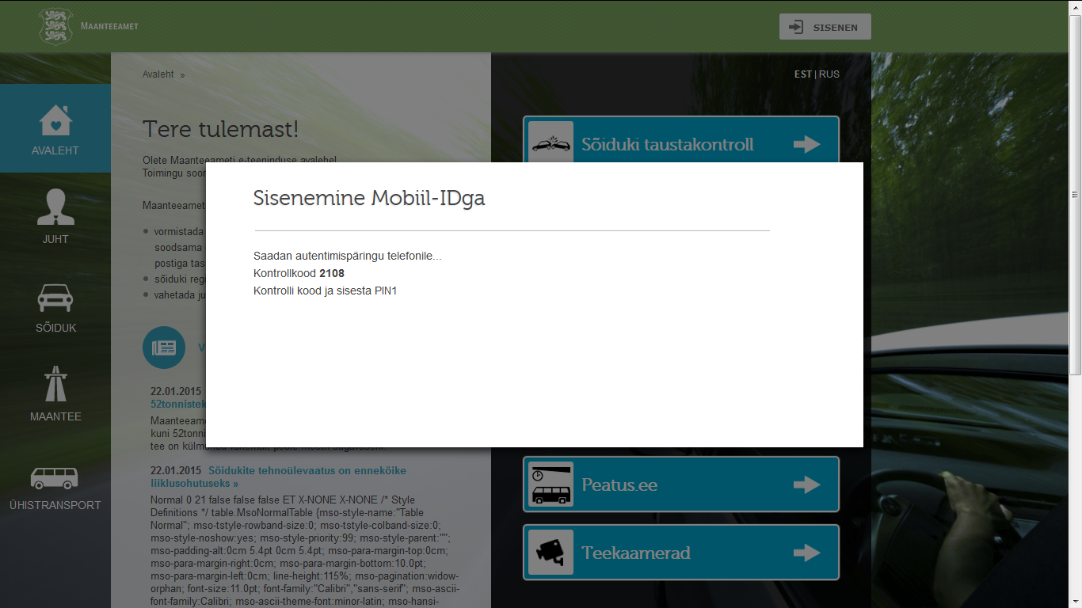
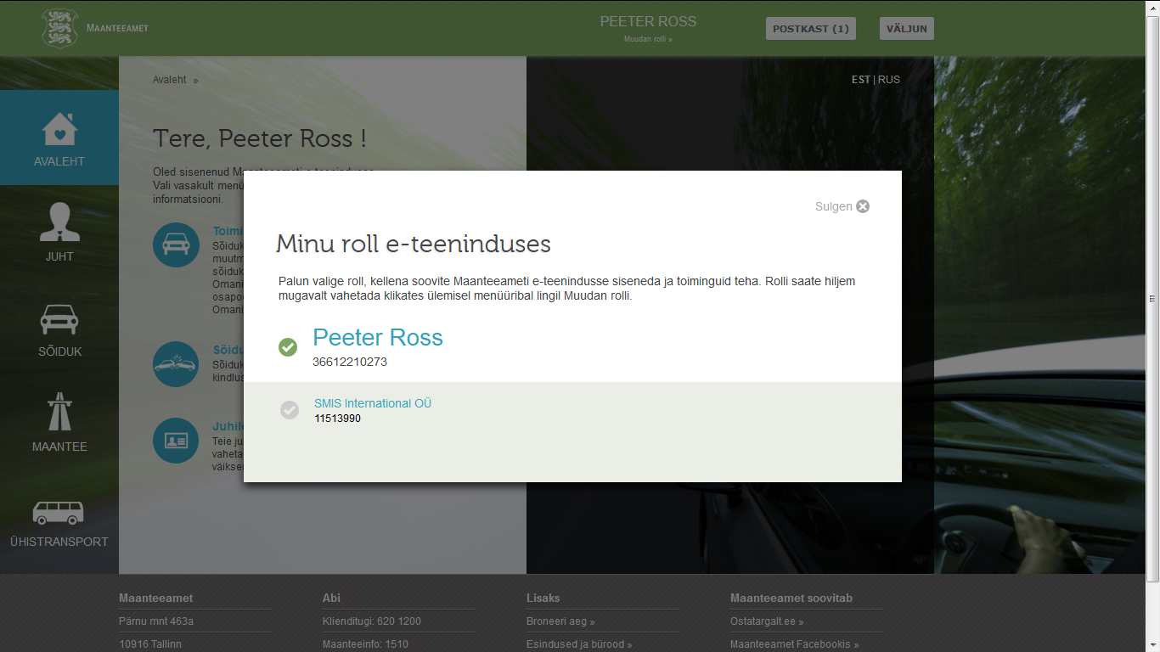
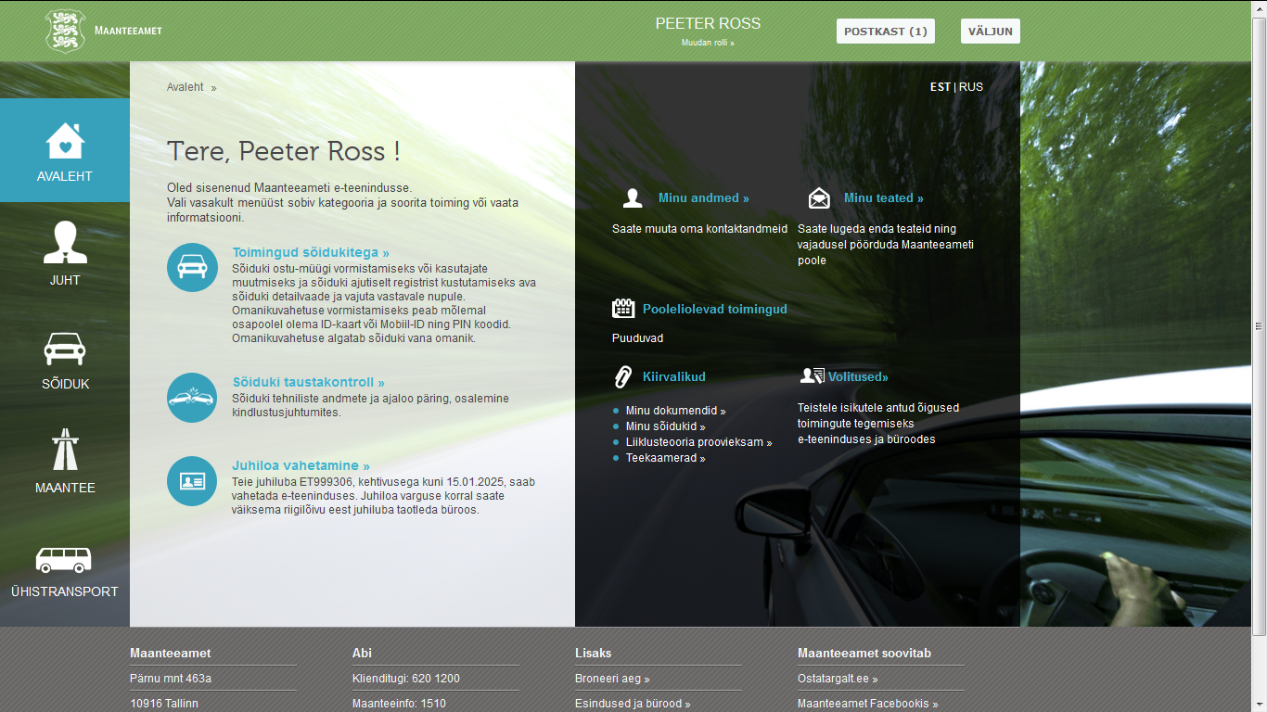
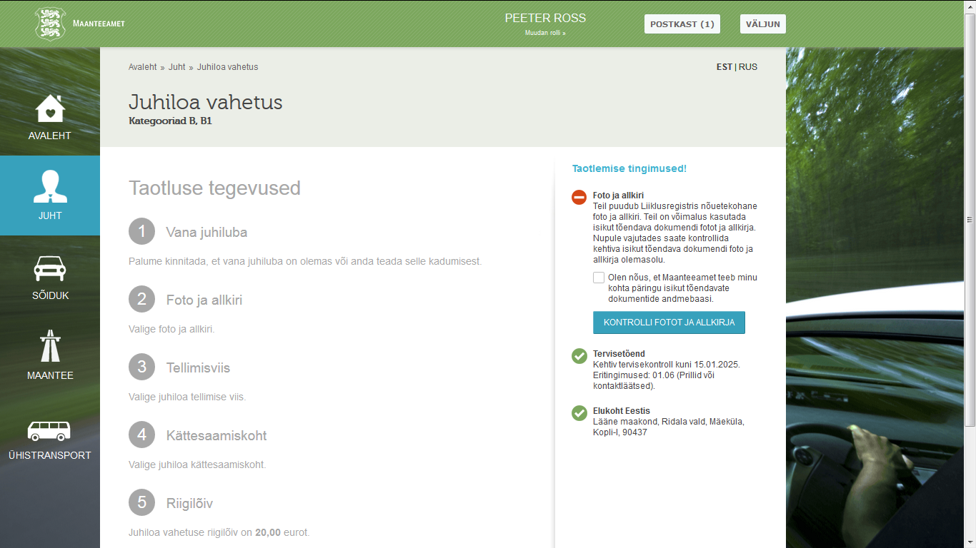
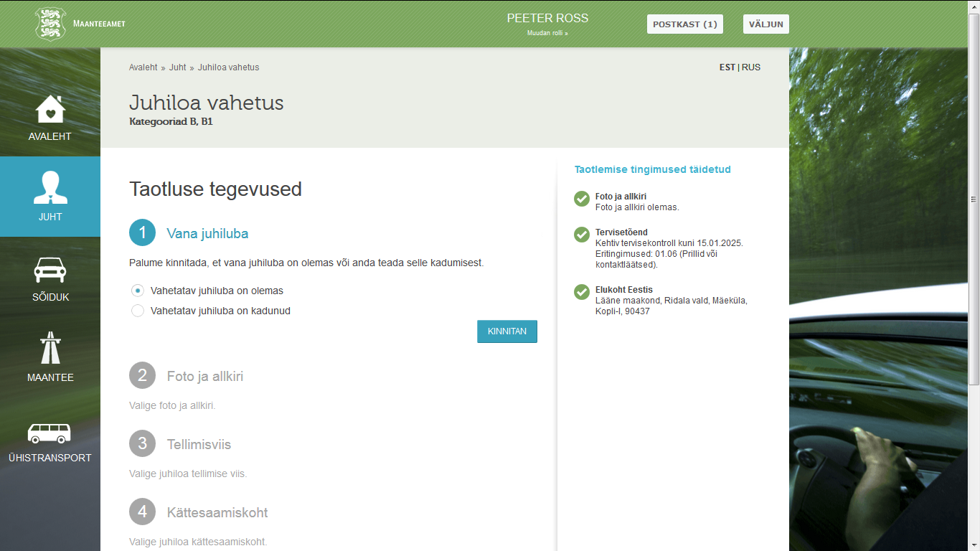
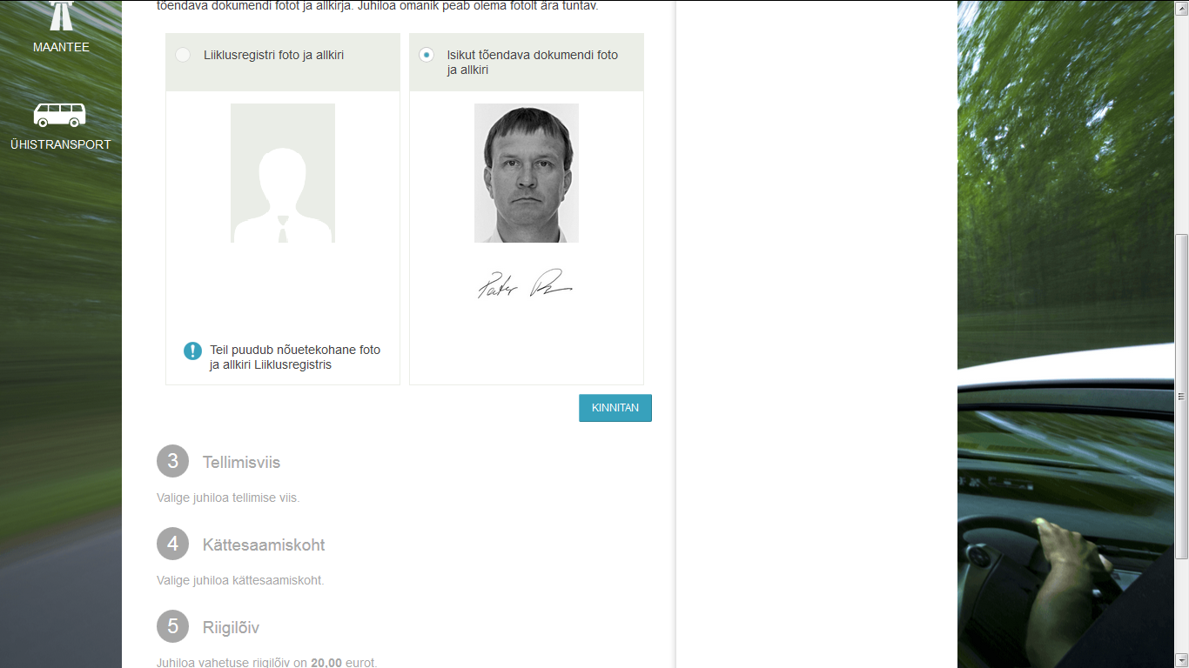
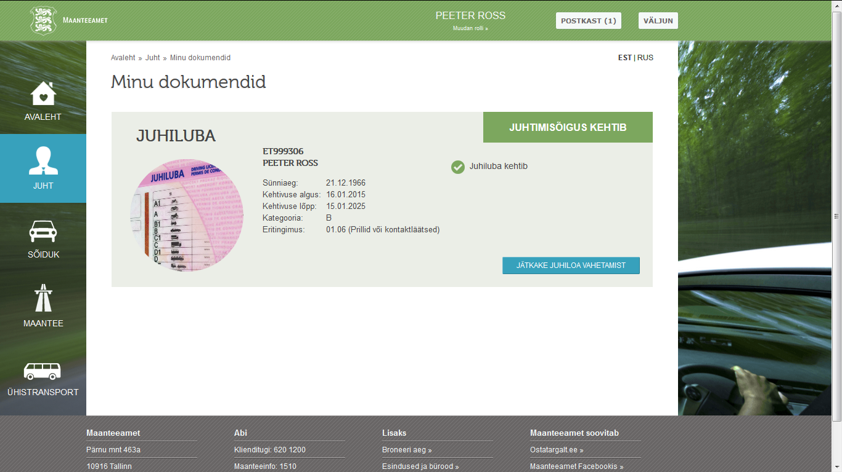
Public service. Driving licence application

Slide 37


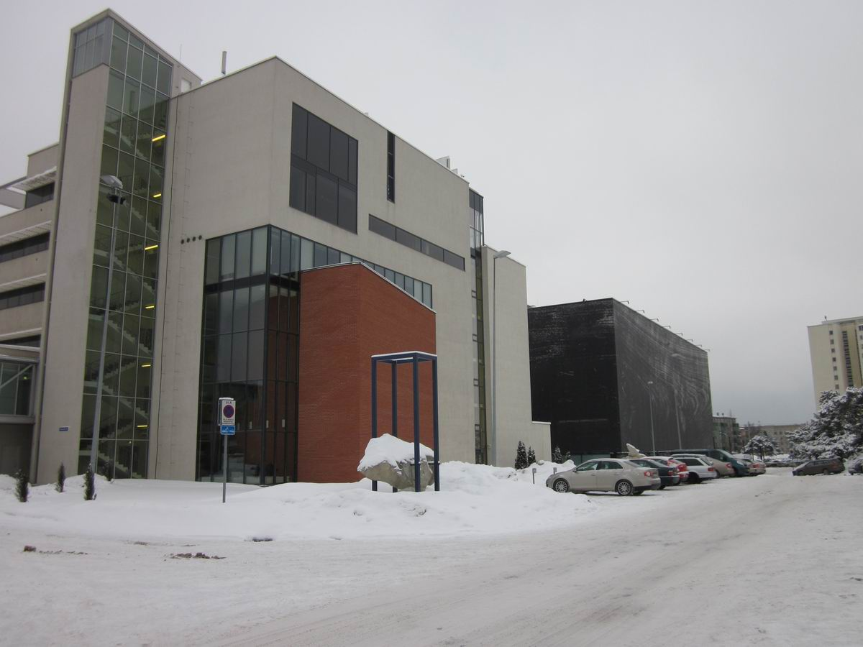
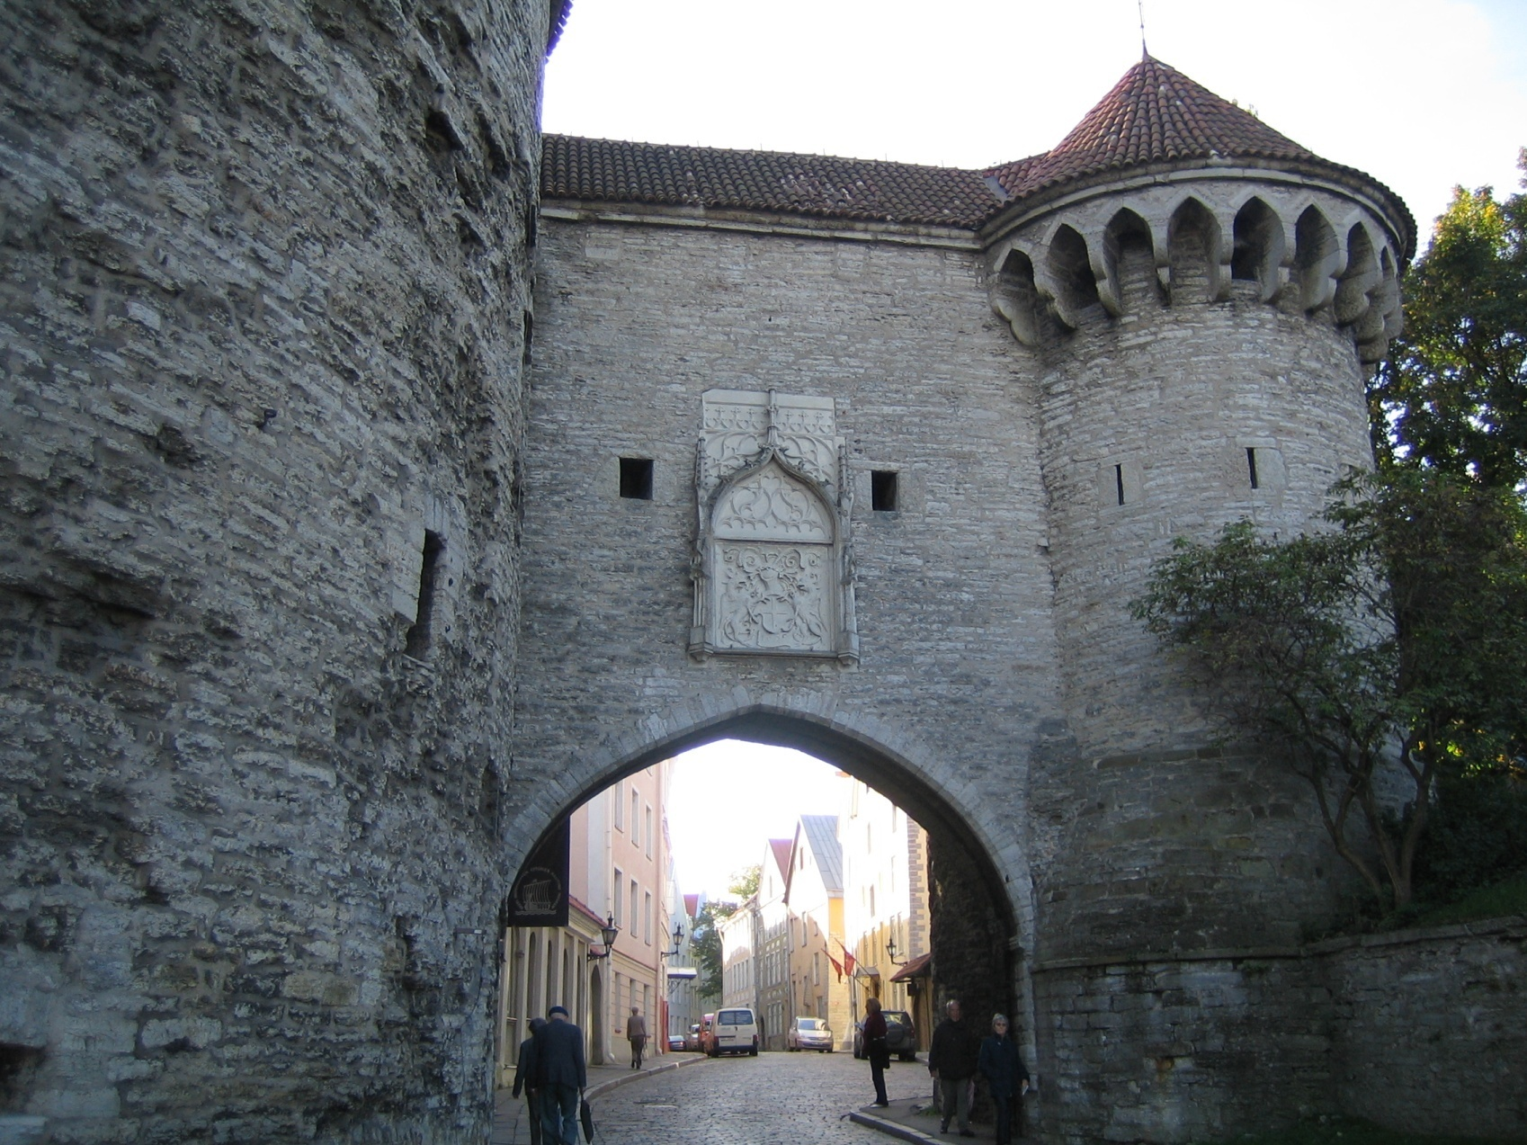
Thank you!
Peeter.Ross@ttu.ee

Slide 38
Servise oriented development
Reduced number of unused bookings
Replacing doctors visits with nurses visits
More efficient time management
Receive medication on time
Prevent complications
Improved self-management of disease
Fewer hazardous examinations
Shorter visit times
Better overview of personal medical data
Patient can add personal self-monitoring data
Research of personalized healthcare/ medication
Interactive prevention of disease for citizen
Benefits to achieve
Citizen
Healthcare provider
Society
Define user case
Sustainability of healthcare systems
Chronic disease management
Efficiency of patient pathways
Innovation in health – innovative models of care
Challenges of healthcare
Business process development
Basic process
Supportive processes
Roles, stakeholders
Data, materials
Service user
Patient portal
Secure authentication
Process
Shared services
Case stories
Standard contents
Service levels
Owners
Service users
Service providers
Services
Prescription
Care process
Documentation
Billing
Diagnostic
Medical record
Working process
optical network
Staging/Storage
Security gate
15 Years of e-health development
EHR
Servers
Servers
Application integration
  Messages exchanges
  Users rights
  Sharing data
  Coordination of changes
  Monitoring
Fire alarms
Servers
EHR
Servers
Ntwk
Servers
PACS
ProLiant
Network
Coolinsystem
GP-s EMR
Housing of infrastructure
  Shared serveres
  Shared storages
  Networks
  System maintenance
Data storage
Data storage
Coolingsystem
Ntwk
Servers
ProLiant
Integrity
Network
Storage
Storage
Electrical network
Integrity
HIS
Prescription
repository
LAN
& Backup
& Backup
Registry
Servers
Servers
LAN
Electricity , UPS
Gateway
Electricity , UPS
Physical facilies
Ross&Tiik 2011®

